Slide 1
Sogeti Cloud - Kubernetes
Migrate and modernize
New and innovate

Slide 2
Cloud Adoption
Migrate and modernize to the Cloud
New and innovate with the Cloud
Rehost
(lift- shift)
Refactor
(redeploy)
Revise
(devops)
Rebuild
(devops)
New
(devops)
Cloud benefits
Cloud benefits
Time
Cloud benefits
Cloud benefits
Cloud benefits

Slide 3
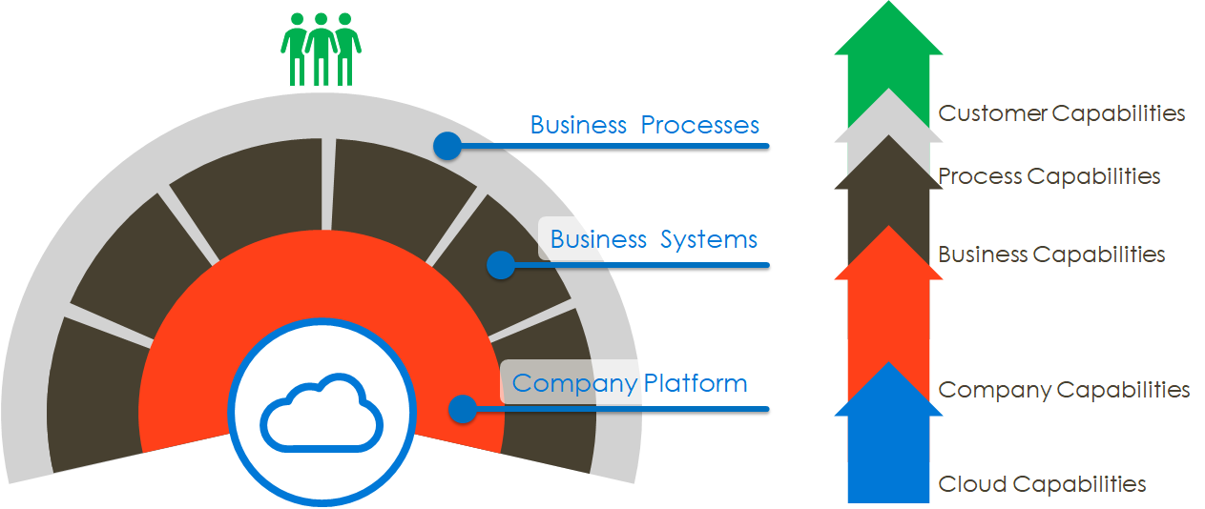
Cloud modernization
Application Portfolio
Landing Platform
Operating Model
Application
Artefact
Cloud Architecture standardization
DevOps Operational guidance and support
Adoption of new cloud merging technologies and ways to manage
Industrialized template management
View on consumption of cloud resources
Standardize Governance Framework
Standardize Service Management Processes aligned to DevOps & Agile Framework
Data Classification
Application Dependency
CMDB
Financial
Security Policy

Slide 4
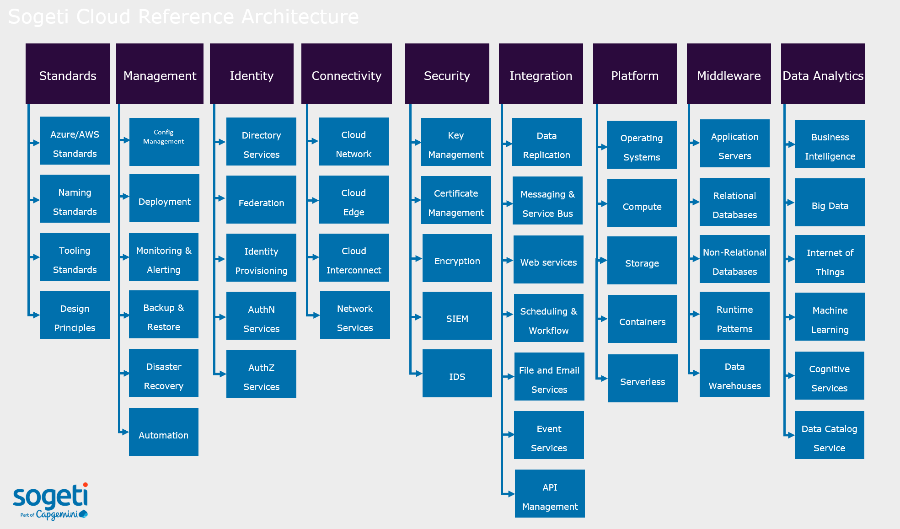
Sogeti Cloud Reference Architecture
There is a both-way dependency between Automation and Cloud. Cloud will facilitate enterprises to bring their IT to a far higher automation level, in a more easy and efficient way the success of cloud and the benefits it will bring is based on the level of automation and the quality of automation within an Enterprise.
Automation requires standardization. Adopting principle-based thinking will help to realize a level of standardization that will bring the framework needed as well as provides flexibility.
The new IT is adopting microservices, rest-API’s and an exploding number of providers. The risk of this fragmentation is a far less efficient and less effective IT within some years within an Enterprise, when DevOps-teams or just Dev- and Ops-teams are not guided by a Framework. The (Sogeti) Cloud Reference Architecture is an example of that kind of framework.
The SCRA is an empiric Framework which we have been working on since 2012, when we started with our first large Cloud adoption project, and today we are still improving the framework with new lessons learned, principles and rules.
The SCRA can be used as fundament to create an enterprise specific Cloud Reference Architecture. This framework will help to organize the Cloud Journey in the most efficient way, adaptive Agile as well as traditional ways-of-working (multi speed).
The SCRA community works close with the Microsoft Patterns and Practices team and aligns with the Microsoft Cloud Adoption Framework.
Design Principles, Standards and Practices for Cloud

Slide 5
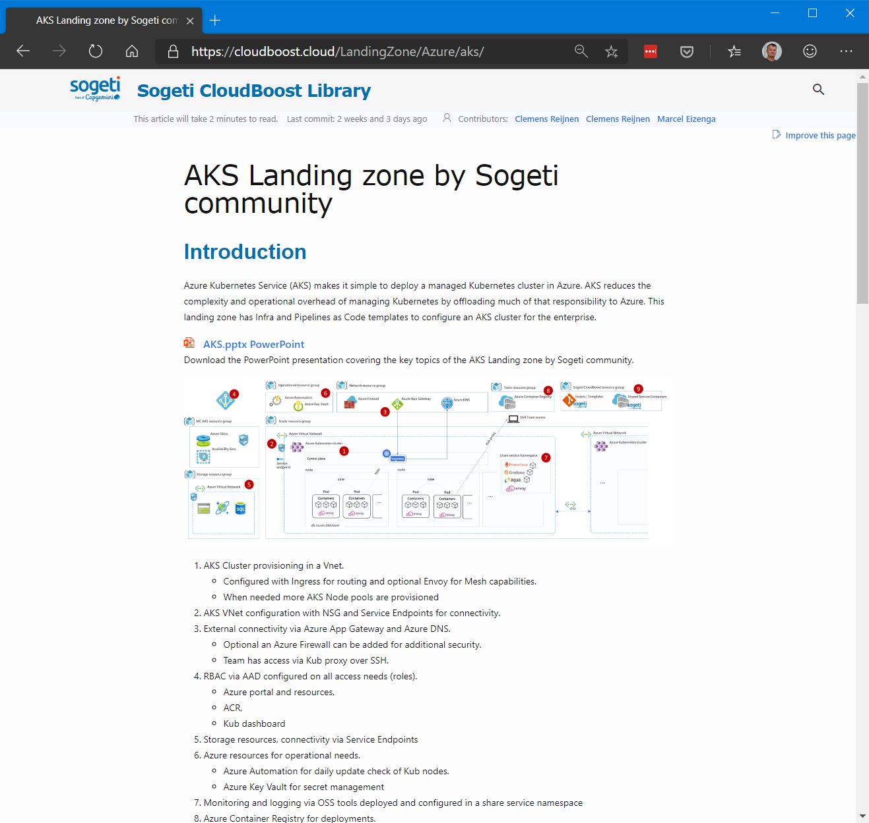
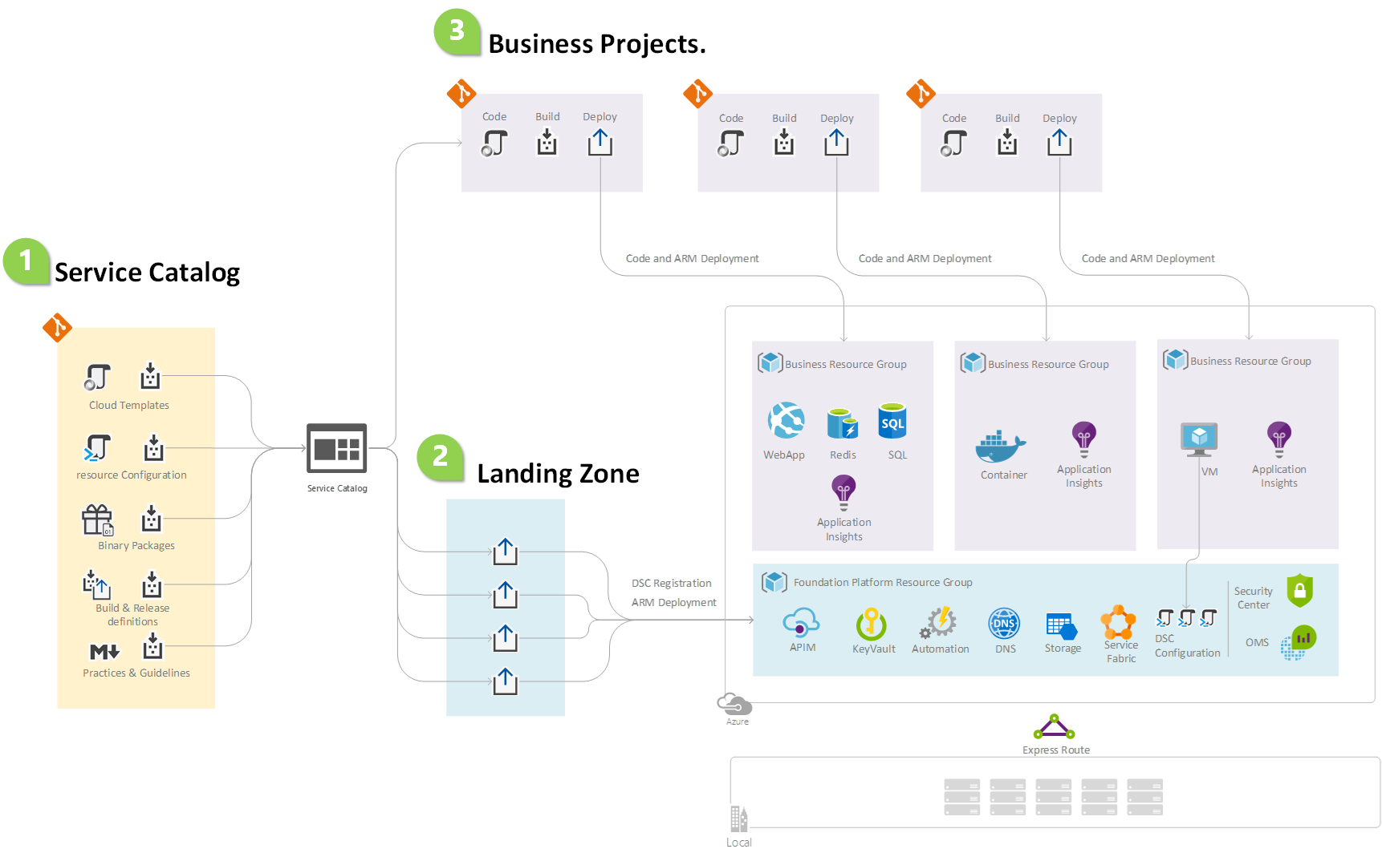
CloudBoost – Landing zone
CloudBoost is a collection of ‘as code’ templates and scripts for cloud infrastructure provisioning. Created and maintained conform industry and enterprise best practices for optimal and mature enterprise cloud and DevOps adoption.
Increased speed, efficiency for cloud environment provisioning
Reduced human errors due to standardizes scripts & templates
Best environment design and security principles implementation
Reduced landing zone provisioning efforts up to 40%

Slide 6
CloudBoost Library
Migrate and modernize to the Cloud
New and innovate with the Cloud
Rehost
(lift- shift)
Refactor
(redeploy)
Revise
(devops)
Rebuild
(devops)
New
(devops)
Enterprise readiness
Cloud benefits
Cloud benefits
Less time
Time
Cloud benefits
Sogeti CloudBoost Library
Cloud benefits
Cloud benefits

Slide 7
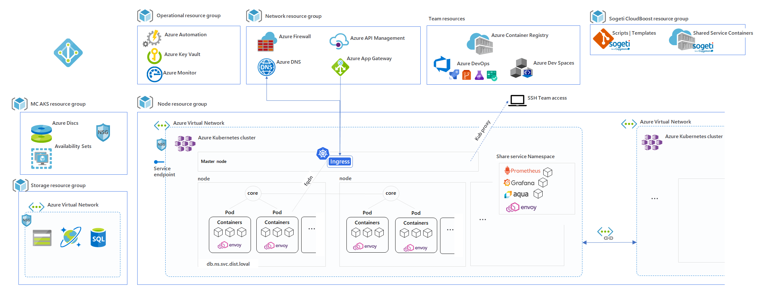
Solution Approach
Application re-writing - Cloud Landing Zone
Utilizing Sogeti CloudBoost library’s AKS Landing Zone design, templates and scripts, we ensure a fast and mature setup of the Customer AKS landing zone.

Slide 8
Migration and Modernization
1
2
3
4
DISCOVER
Collect applications, dependencies, business needs and priorities for planning and scope migration. Define the migration waves based on priorities, system dependencies and target landing platform (containers / VM’s).
ASSESS
Assessment per application on complexity for containerization, lift shift or DevOps.
PREPARE
Prepare release pipelines (based on CloudBoost Pipeline as Code repository, see next slide) with ING DevOps team. Containerize, validate and deploy or provision VM, deploy, validate.
MIGRATE & MODERNIZE
Migrate and or modernize to public or private cloud the lift shift way but preferable the DevOps way
TARGET OPERATING MODEL
Cloud augment ToM
LANDING PLATFORM
Setup and mature landing zone for VM’s and containers based on AKS with Customer LZ team. Using and creating a CloudBoost library.

Slide 9
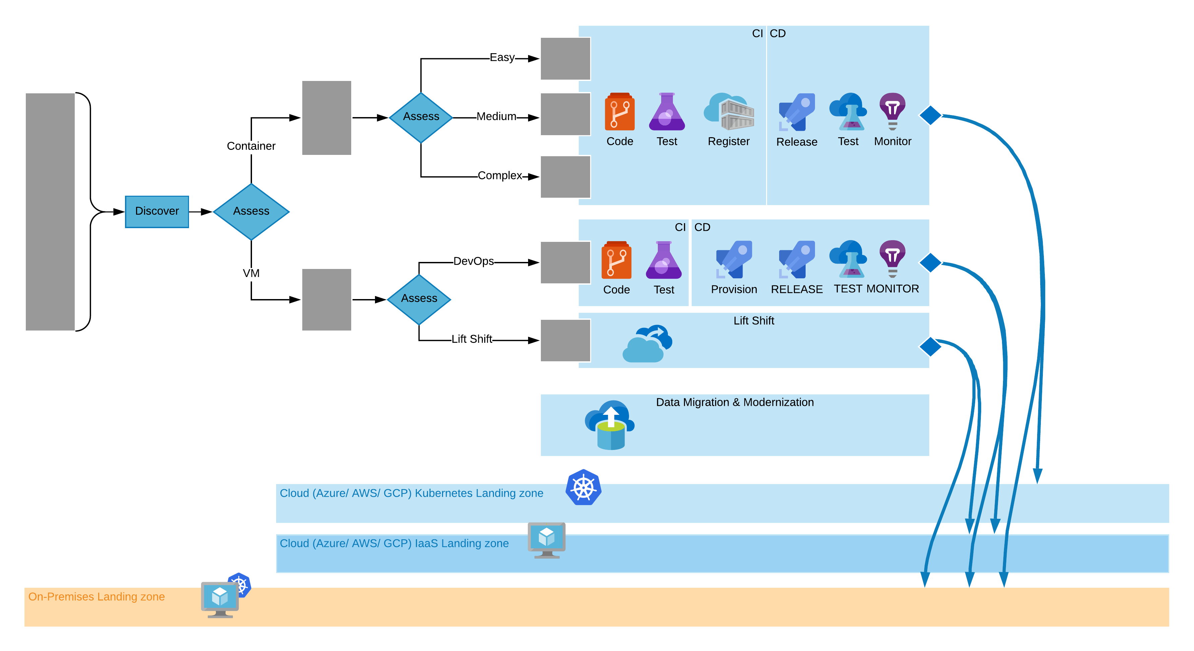
Migration and Modernization
1
Discover. Collect applications, dependencies, business needs and priorities for planning and scope migration. Define the migration waves based on priorities, system dependencies and target landing platform (containers / VM’s).
3
7
2
Assessment per application on complexity for containerization, lift shift or DevOps.
1
2
Prepare release pipelines (based on CloudBoost Pipeline as Code repository, see next slide) with customer DevOps team. Containerize, validate and deploy or provision VM, deploy, validate.
3
4
4
Prepare migration for lift shift.
5
data sync with the source environment and re-establish the data flows
5
6
Setup and mature landing zone for VM’s and containers based on AKS with Customer LZ team. Using and creating a CloudBoost library.
6
7
Migrate to public or private cloud

Slide 10
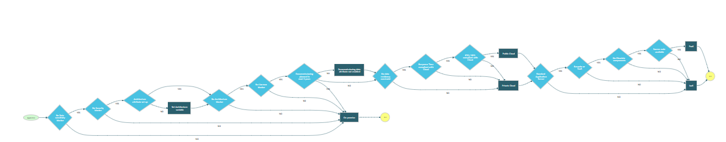
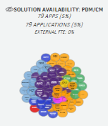
Discover and Assess – Fully automated decision triaging
Select candidate applications and servers according to a Decision Tree
1
Possible Cloud blockers
2
Public vs. Private decision
3
IaaS vs. PaaS decision
Applications to be assessed
Security Requirement
Highly
Sensitive data
Architecture blocker
Not Cloud eligible

Slide 11
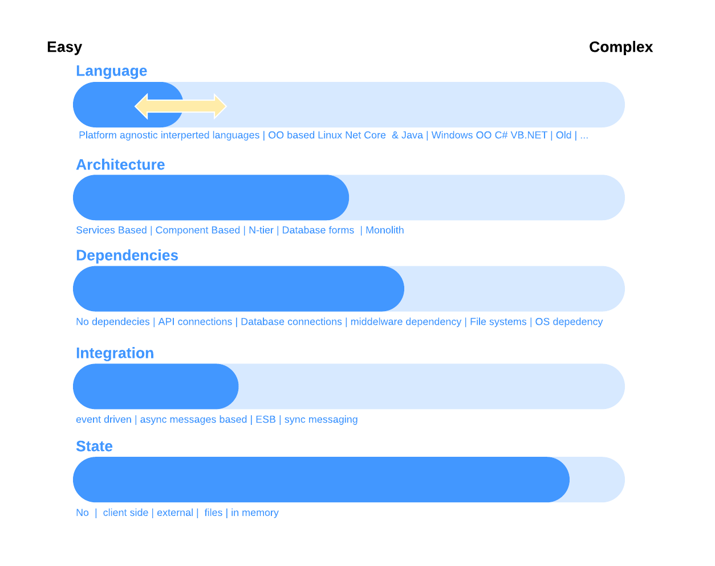
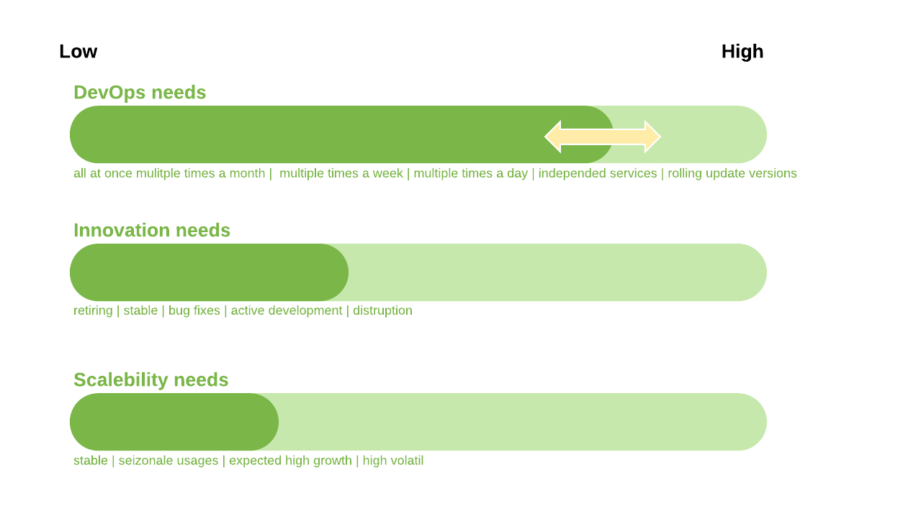
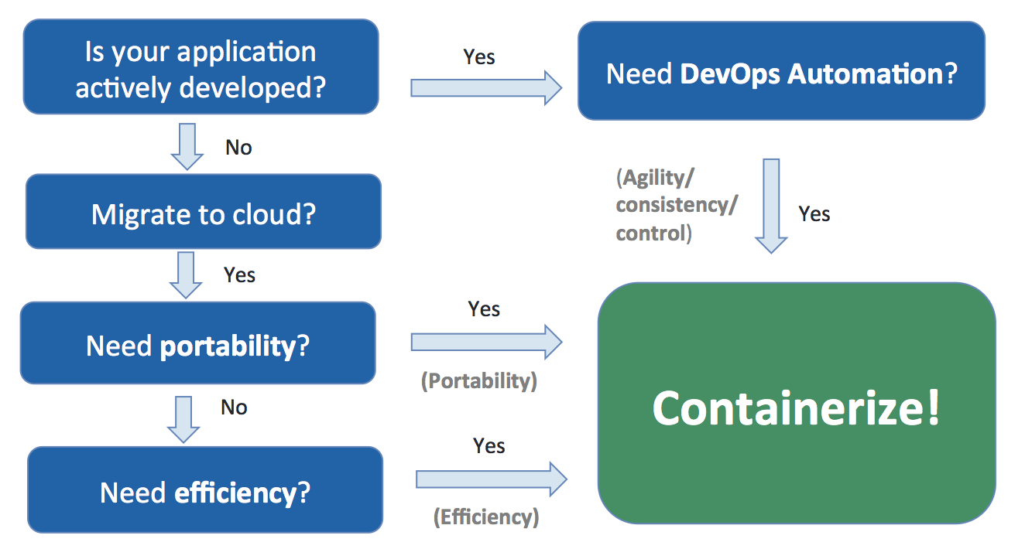
Business case - modernize to container technology
Based on output from the eAPM, Code analyzer and (optional) Evolveware applications are evaluated on containerization complexity.
Capability of licenses.
Business case evaluated based on application needs and complexity.

Slide 12
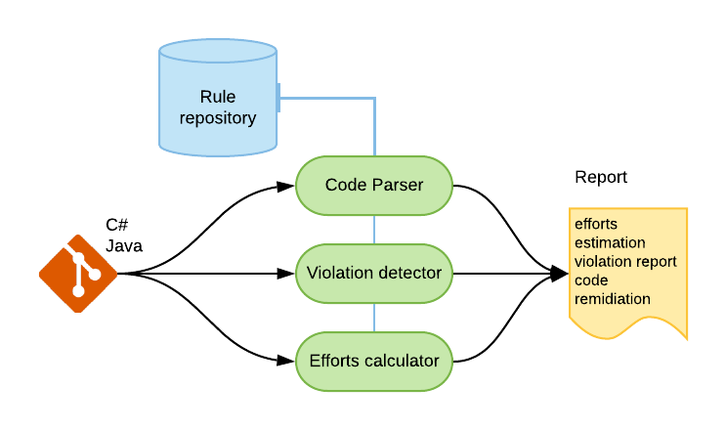
Modernize to container technology assessment
OneDeliver Code Analyzer
Understand existing application architecture and the Re-Write complexities.
Assess source code on compliance and suitability to use PaaS Cloud services and Container technology.
Report on complexity, risks and estimation for migrations.
Separation of: Code – Configuration – Data

Slide 13
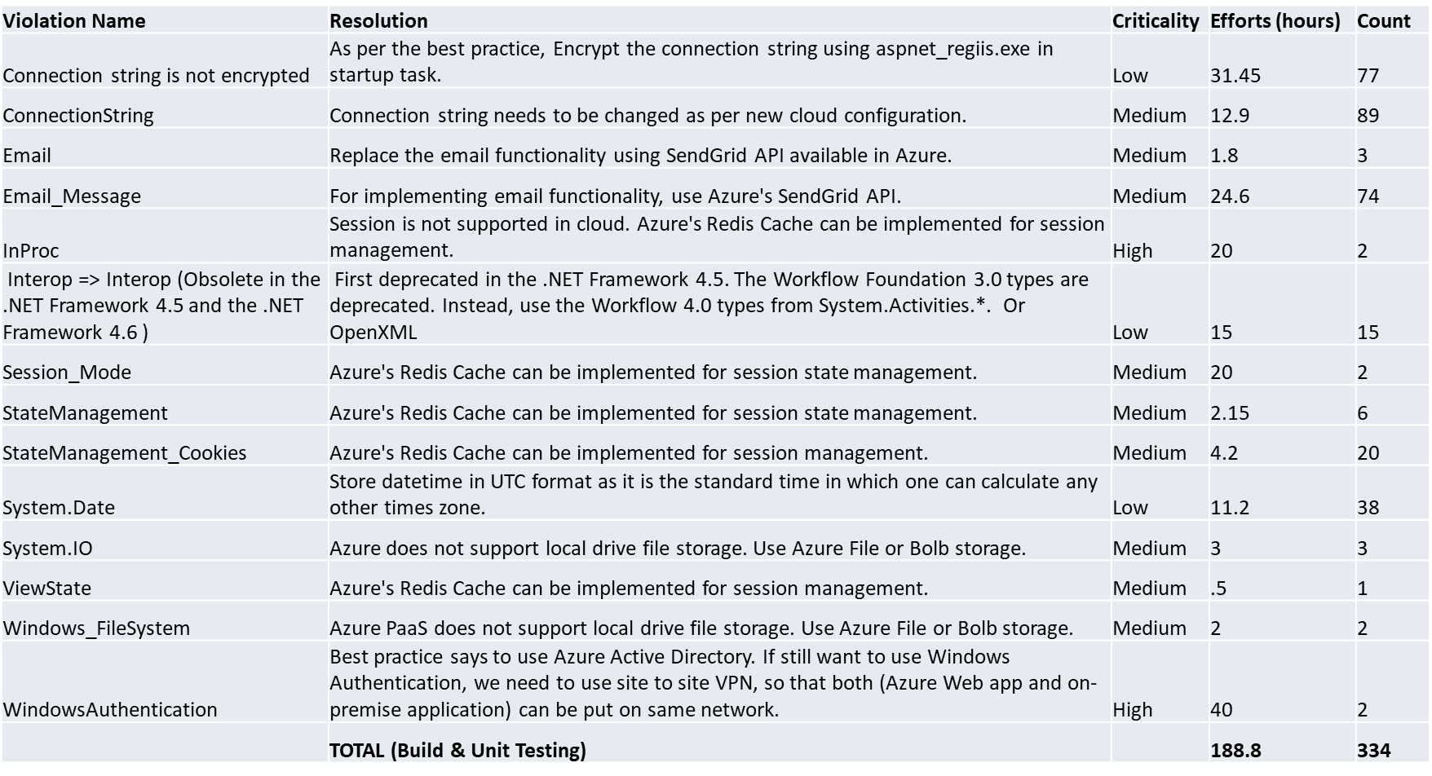
OneDeliver Code Analyzer
Sample mitigation and estimation report

Slide 14
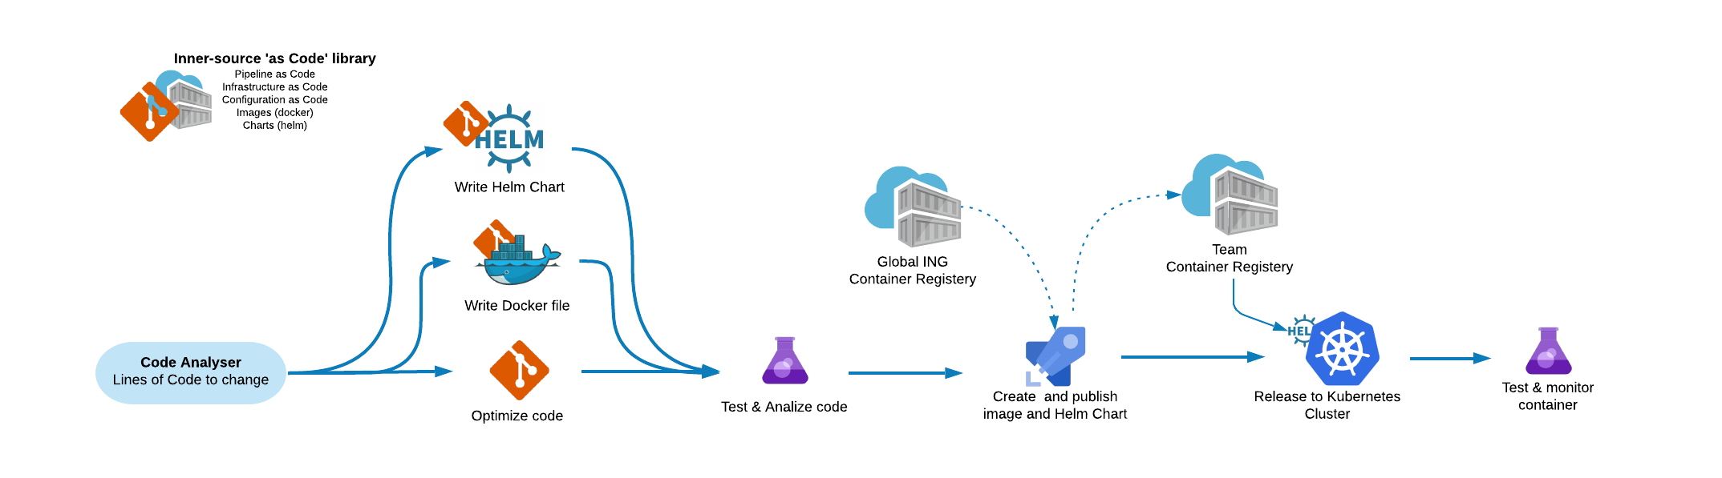
Refactoring & revising – using containerization
2
3
4
1
Prepare modernization with Code Analyzer and or Evolveware for needed code changes.
Create Docker file and Helm chart by using templates from Inner source Git Repository.
Create Docker image and Helm chart by using internal ING registry.
Publish Container packaged application and Helm chart to team registry for deployment to Kubernetes (Public or Private Cloud).

Slide 15
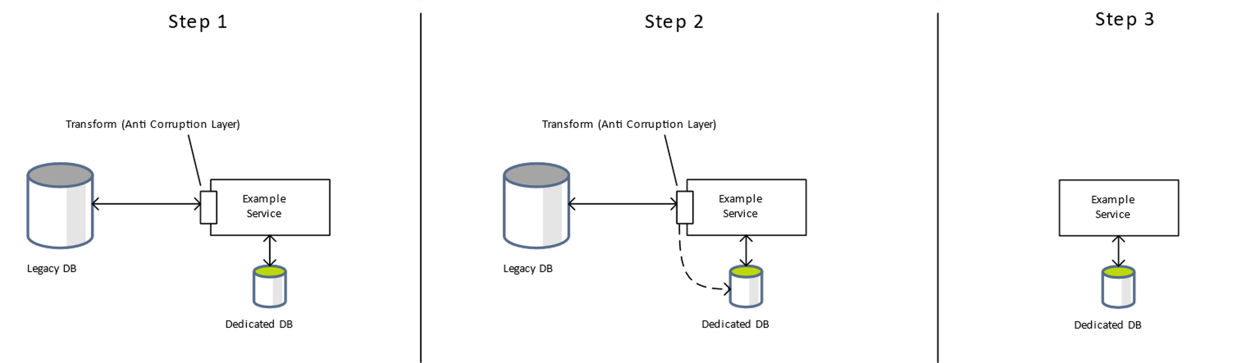
Solution Approach
Data migration approach
In the development phase, we’ll re-use the current legacy database, while transforming into the dedicated database for each service. This will allow a smoother migration experience, and we can work on the separate services in parallel without blocking one another. Once in production, the services will have its own database, with no dependency on the legacy database.

Slide 16


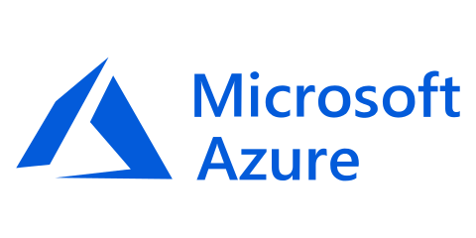
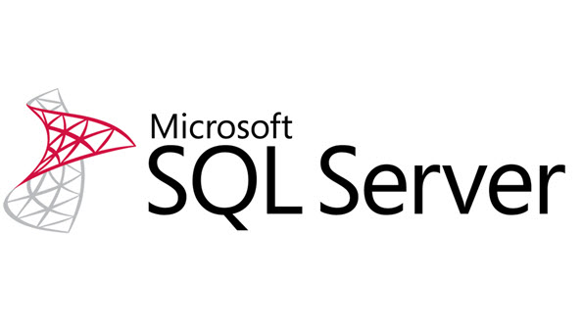
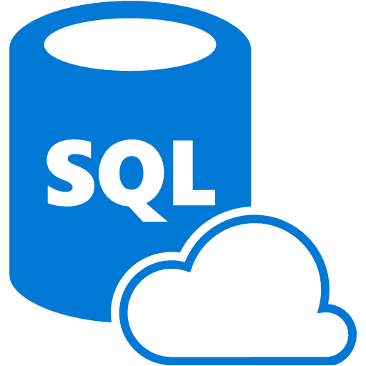

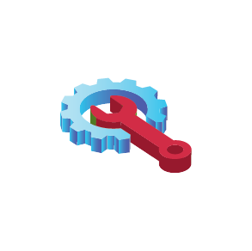
Database Migration – On Premise to Azure PaaS Instances
Partner Rotation DB On-premise
DB object Import & Update
Post Development Validation
Partner Rotation PaaS DB
Use SSMS Steps to perform Import
Data Verification and Reconciliation
Data Discovery and Profiling
*.sql
Import
Transform/Publish
Performance Optimization
Schemas
Schema and Code migration
Publish
Export/Import
Data Extraction and Loading
Database Schema & Data Migration
Azure SQL DB Instance with Data
Copy
Copy DB
Quality and Security Configuration
SQL DB on PaaS
Monitoring and Administration
Managed Instances

Slide 17
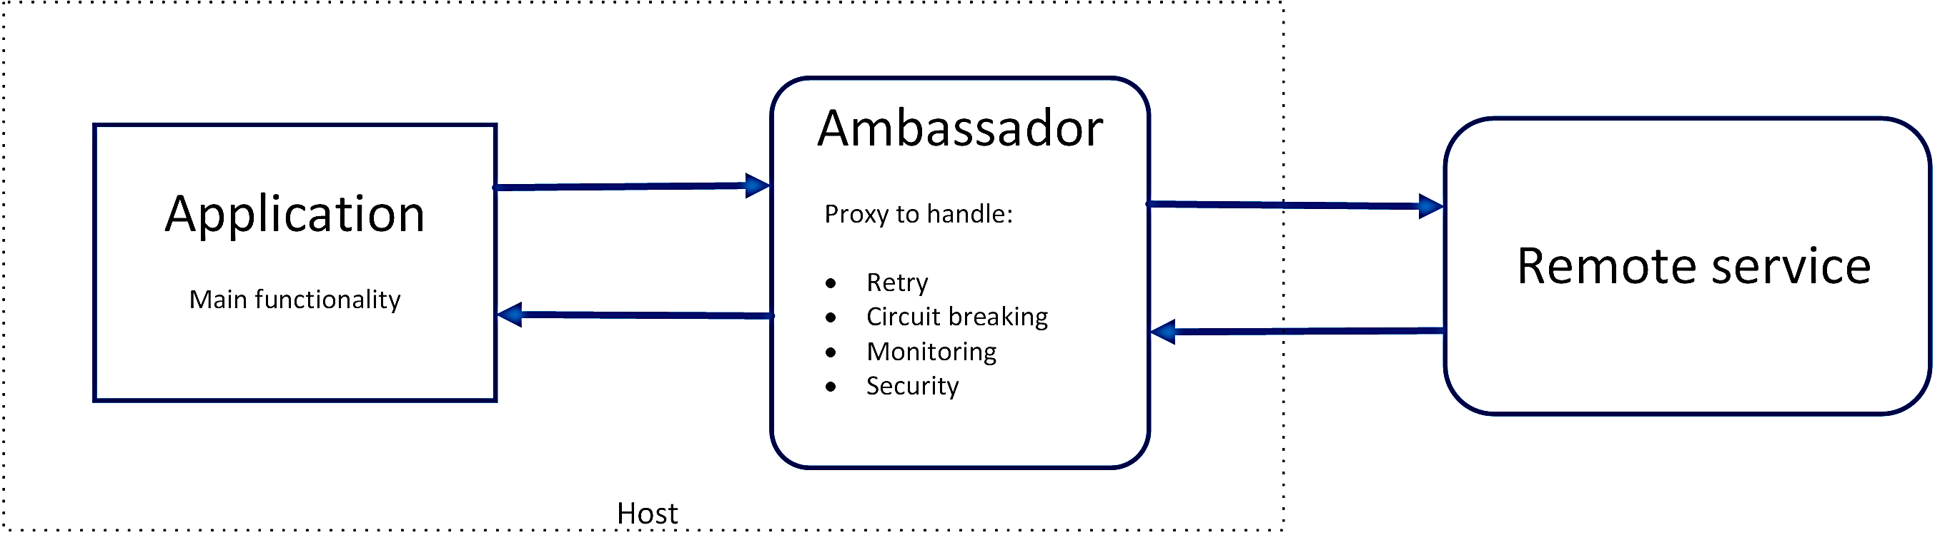
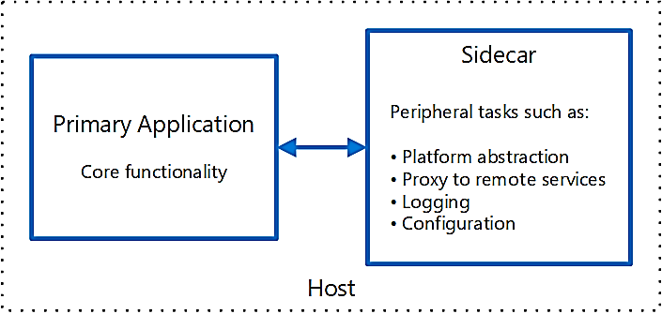
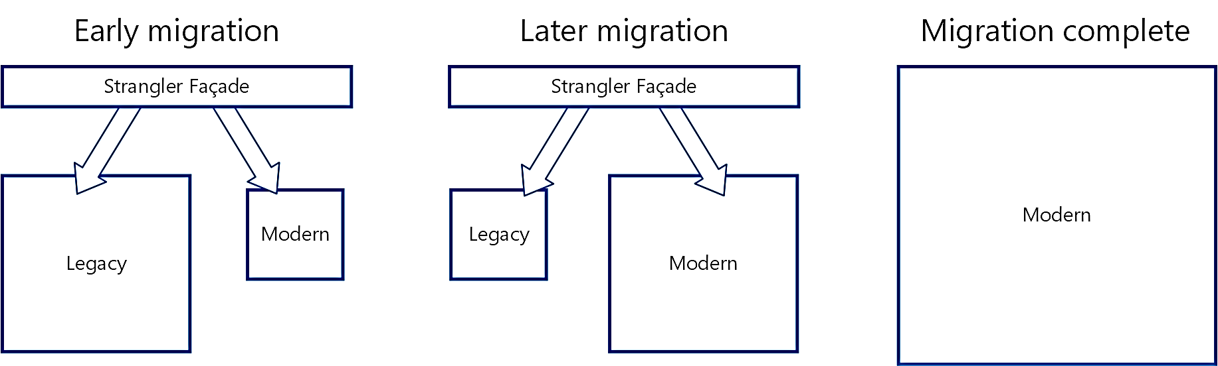
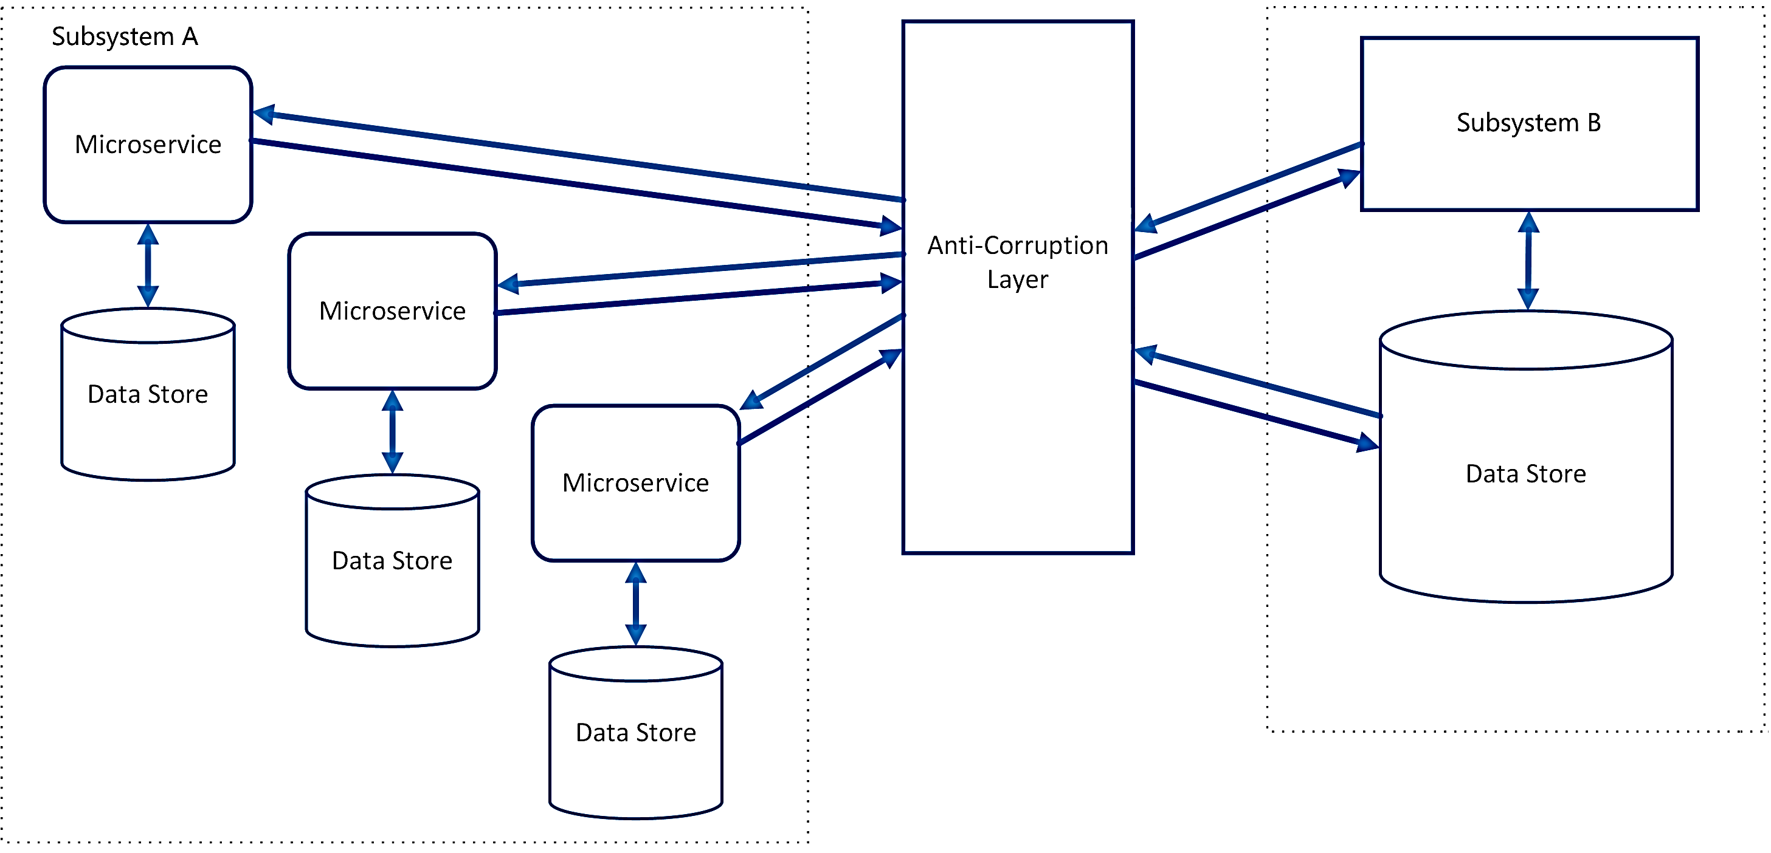
Architecture – Design Patterns
Ambassador: Helper service that sends network requests on behalf of consumer service agents.
Sidecars :These services are separate applications and tightly coupled to parent application, provides higher isolation and encapsulation.
Strangler : Expedite the refactoring process of monolithic applications incrementally.
Anti-corruption layer : Enabler for legacy modernization. This stuffed with all the implementation logic to translate the communication requests among the participating systems

Slide 18
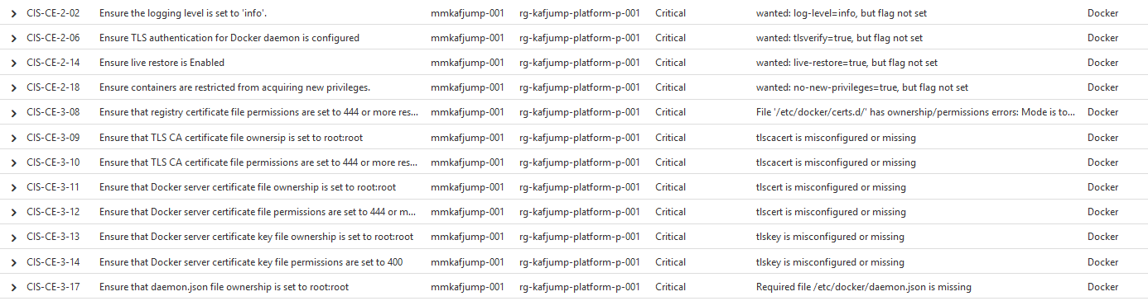
SOC Container Services
Security Services.
container images scanning with vulnerability management solution
monitoring container configurations with Azure Security Center.
Pod Security Policy, Container vulnerabilities and Networking restrictions.
CIS docker standardizations

Slide 19

Cloud Native Applications – Sogeti Kubernetes
Packaged in containers | Deploy as microservices | Manage with DevOps
1
2
3
4
5
AKS enterprise ready Terraform templates and Azure Pipelines as Code automation.
Sogeti inner-source “CloudBoost library“ project holds a landing zone design for enterprise adoption of AKS conform the Sogeti Reference Architecture.
Fast setup a mature AKS platform and keep the focus on business value.
OneDeliver Kubernetes Managed Service
Sogeti OneDeliver Azure MSP and Kubernetes administrators create and manage any AKS cluster conform Microsoft and Sogeti standards.
Local Kubernetes Experts
Sogeti local countries setup designs and microservice solutions together with OneDeliver and customer DevOps teams to optimize the benefits of Cloud and Microservices. Supported by the Sogeti global AKS expert's community and Microsoft.
Kubernetes Secure Operating Center Service
A vulnerability management managed service solution with Pod Security Policy, Container vulnerabilities and Networking restrictions conform CIS (Center for Internet Security)
Microservices Thinkubator based on AKS.
A 3 month iterative joined project to get business value from advanced technology in the core of your company.
The perfect way for an organization to instantly fall in love with a new Technology

Slide 20
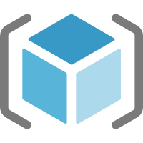


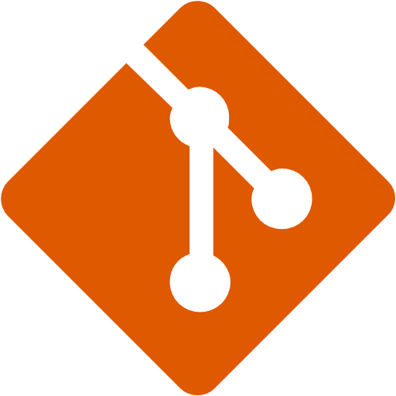
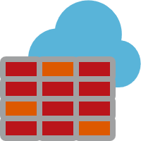

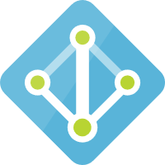
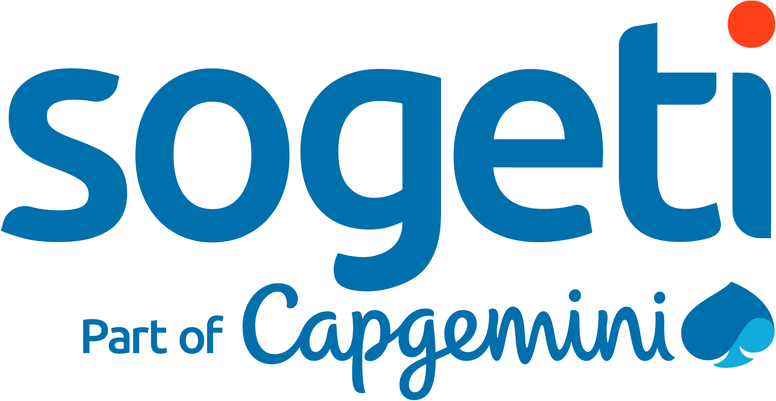




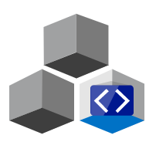






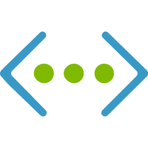
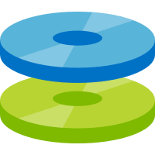

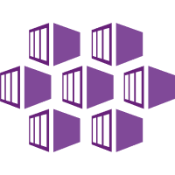


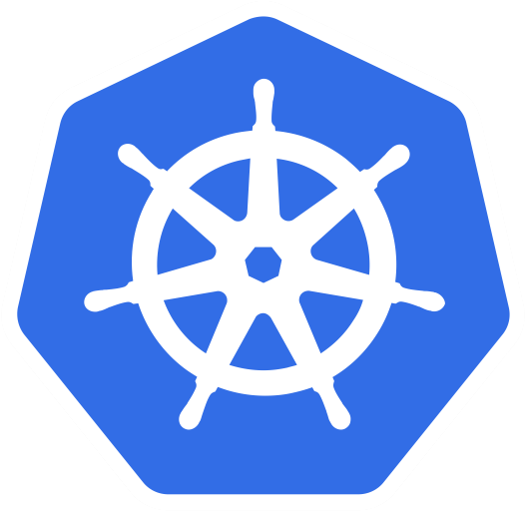



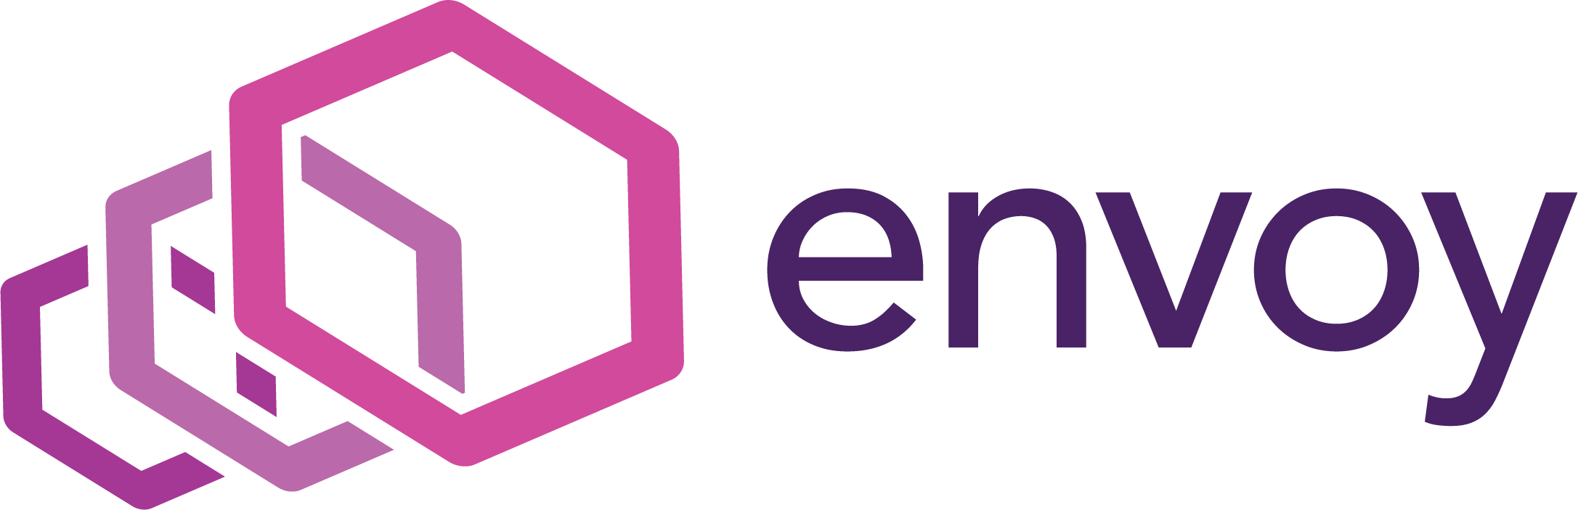


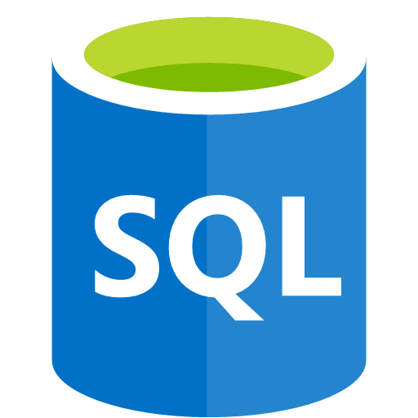
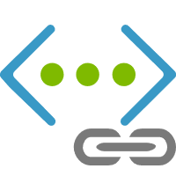
Operational resource group
Network resource group
Team resources
Sogeti CloudBoost resource group
Azure Automation
Azure Container Registry
Scripts | Templates
Shared Service Containers
Azure Firewall
Azure API Management
Azure Key Vault
Azure App Gateway
Azure DNS
Azure DevOps
Azure Dev Spaces
Azure Monitor
SSH Team access
MC AKS resource group
Node resource group
Azure Discs
Azure Virtual Network
Azure Virtual Network
Kub proxy
Azure Kubernetes cluster
Azure Kubernetes cluster
Availability Sets
Master node
Share service Namespace
Ingress
Service endpoint
node
fqdn
node
Storage resource group
core
core
Azure Virtual Network
Pod
Pod
Pod
Pod
Containers
Containers
Containers
Containers
db.ns.svc.dist.loval

Slide 21
Operational resource group
Network resource group
Team resources
Sogeti CloudBoost resource group
Azure Automation
Azure Container Registry
Scripts | Templates
Shared Service Containers
Azure Firewall
Azure API Management
9
6
8
4
Azure Key Vault
Azure App Gateway
Azure DNS
Azure DevOps
Azure Dev Spaces
Azure Monitor
3
SSH Team access
MC AKS resource group
Node resource group
Azure Discs
2
Azure Virtual Network
Azure Virtual Network
Kub proxy
1
Azure Kubernetes cluster
Azure Kubernetes cluster
Availability Sets
7
Master node
Share service Namespace
Ingress
Service endpoint
node
fqdn
node
Storage resource group
5
core
core
Azure Virtual Network
Pod
Pod
Pod
Pod
Containers
Containers
Containers
Containers
db.ns.svc.dist.loval

Slide 22
Operational resource group
Network resource group
Team resource group
Sogeti CloudBoost resource group
9
6
8
4
Azure Automation
Azure Container Registry
Scripts | Templates
Shared Service Containers
Azure Firewall
Azure App Gateway
Azure DNS
Azure Key Vault
3
SSH Team access
MC AKS resource group
Node resource group
Azure Discs
Azure Virtual Network
Azure Virtual Network
Kub proxy
2
Azure Kubernetes cluster
Azure Kubernetes cluster
Availability Sets
1
Control plane
Share service Namespace
7
Ingress
Service endpoint
node
fqdn
node
Storage resource group
5
core
core
Azure Virtual Network
Pod
Pod
Pod
Pod
Containers
Containers
Containers
Containers
db.ns.svc.dist.loval
…
AKS Cluster provisioning in a Vnet. Configured with Ingress for routing and optional Envoy for Mesh capabilities. When needed more AKS Node pools are provisioned
AKS VNet configuration with NSG and Service Endpoints for connectivity.
External connectivity via Azure App Gateway and Azure DNS. Optional an Azure Firewall can be added for additional security. Team has access via Kub proxy over SSH.
RBAC via AAD configured on all access needs (roles).
Azure portal and resources,
ACR,
Kub dashboard
Storage resources, connectivity via Service Endpoints
Azure resources for operational needs. Azure Automation for daily update check of Kub nodes. Azure Key Vault for secret management
Monitoring and logging via OSS tools deployed and configured in a share service namespace
Azure Container Registry for deployments.
Sogeti CloudBoost library with reusable scripts, templates, pipelines and containers

Slide 23
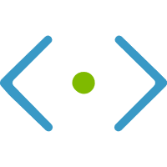

Virtual Network
Subnet
Network security group
Azure Kubernetes cluster

Slide 24
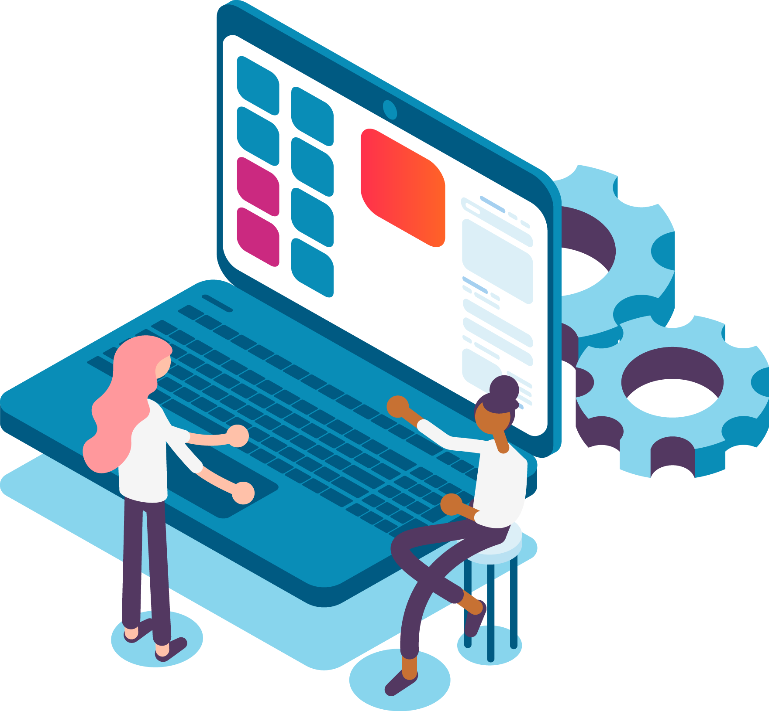


Solution Drivers for Modernization
Solution Drivers for Modernization
Current Technical Challenges and Objectives
Enhance service offering to the market regarding connectivity and digital services
Migrate from the current on-premises infrastructure into a cloud platform
Achieve Agility and scalability
Shift current monolithic architecture to a decoupled scalable architecture.
Explore possibilities to leverage platform and analytics to drive new opportunities
Strengthen current Agile practices & DevOps culture
Implement DevOps Automation, Continuous development, Continuous integration
Improve Project Governance & development practices
Re-design to bring about a decoupled scalable architecture
Redesign the Architecture leveraging best technology agnostics approach
Security and quality checks during entire solution lifecycle
Ensure Solution design and implementation are manageable
Enable innovation & transformation in solution for better ROI
All rights reserved.
24

Slide 25
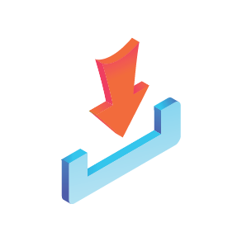

Sogeti Understanding of Scope
IN Scope
OUT of Scope
APPLICATION COMPONENTS
…
…
Technology
Deployments to the Dev and QA environment will be doing using Pipelines.
Testing
Creation and execution of QA test cases.
Automated test using … for critical and complex application components
Bugs logged, tracked and reported on using …
Support business UAT testing
Assumptions
…
Project Management
Creation of Project Governance plan, project timeline, risk and issue register
Project status reporting to project team, stakeholders and PMO
tion
April
© 2019 Sogeti. All rights reserved.
25

Slide 26
Solution Approach & Roadmap

Slide 27
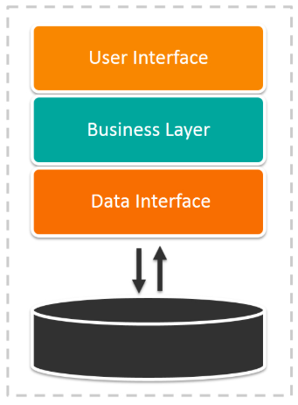
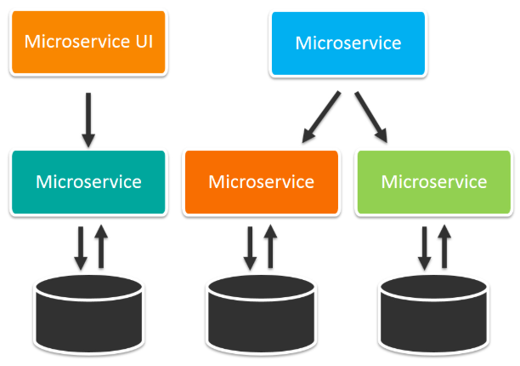
Our Proposed Approach and Recommendation
Sogeti views that microservices take off from where current approaches fail or face limitations. Designed as a suite of small services, each catering to a particular function, microservices architecture has become an integral part of web, mobile, and internet-of-things (IoT) applications.
Monolithic System
Microservices Oriented System
1
Accelerate Turnaround
2
Fault Tolerance, Isolation & Resilience
3
On Demand Flexibility & Scaling
4
Cost Effective Change
5
Agility & Automation
CURRENT CHALLENGES
Automation in integration difficult to implement
CURRENT LIMITATIONS
Code base is old
Does not support latest browsers
CURRENT PAIN POINTS
Various different applications that are not integrated
Technology being old, revise cycles are long
Code for different services can be written in different languages
Services can be released, modified independently
The code is organized around business capabilities
Work very well with containers, such as Docker

Slide 28
Sogeti Powered OneNative Development Framework
Identify Right Stake holders
Assessment & Initiation
Design Review Process
Implementation Process
Code Review Process
Testing Process
Strategy & Approach
Re Write
Best Practices
Cloud Reference Architecture (RA)
Cloud Security Principles
RA Reusable Component
Cloud Design Principles
Coding Best Practices
OneNative
Development Framework
OneNative Reference Architecture
OneNative Design Principles
CloudBoost
AcceleRight
OneDeploy
OneShare
Highly Scalable Design
Highly Available Design
Health Monitoring Enabled
Easily Interoperable Design
Innovative technical Solution
Extensible & Flexible Solution
Value Adds
Technology Excellence

Slide 29
Cloud Native Implementation Approach
Our comprehensive build approach with a fully industrialized factory at the core
Initiation & Analysis
Detailed Design
Build - Agile Development, Factory Processes.
Run
App code refactor, configure, move
Testing
Database Development & Testing
Collaborative Design
Provision Dev & Test Environments
Requirement Gathering
Analyse & Review
Conceptual Architecture
Buy vs Build vs Leverage Decisions
Security
Microservices
Production Deployment
Learn & Optimize
OneNative Development Framework
Sequence
Build
Detailed Design Architecture
Management Instrumentation
Monitor
Back-Up
COTS Integration
Service Introduction
Buy
Compatibility
& Feature Verification
Off the Shelf/COTS
Current Operating Model
Cloud (Future) Operating Model

Slide 30
Solution Approach – Initiation & Analysis

Slide 31
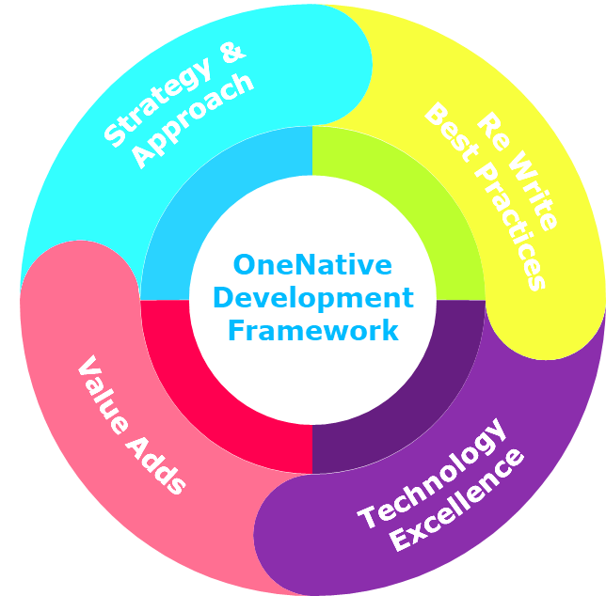
Detailed Discovery Phase
Week 1
Week 2, 3
Week 4
Preparation
Discovery Execution
Deliverables
Identify stakeholders
Pre-requisites & Approvals
Business Requirements
Processes & Standards - Identifying tooling requirements
Platform Requirements
Analyze Current System
Architecture and Integrations
User stories verification
Participant Roles – PM, BA, Architect, Tech Lead
Analyze target state and NFRs
Analyze Performance, Scalability, Availability, Portability
Partner Rotation Rewrite Requirements
Analyze Re-Write Candidates
Build vs Buy – Requirements, Decisions, Integrations
Partner Rotation Technical & Deployment Architecture
UI & Microservices Designs
DevOps and Agile Development and Governance plan
Security Architecture
End to end monitoring approach
Buy vs Build vs Leverage Strategies
Analyze Systems, Connectivity, Aggregation and Integration methodologies
Determine Data Flow, Capture, Storage, Data Feed Approach
Analyze Test & Test automation tools and practices
Analyze user stories vs UI screens
Participant Roles – PM, BA, Architect, Tech Lead, Test Lead, Angular UI Developer
Implementation plan & Estimate
User Stories Backlogs
Architecture Design
Microservices Architecture – Logical Architecture, Data Flow approach, Stateful vs Stateless
Integration Approach and Architecture
Cloud Technical Architecture – Cloud Services, Custom Components, DevOps
Cloud Deployment Architecture – Azure PaaS vs AKS, Serverless, Containerized
Identity Providers – Providers and Integration Models
Participant Roles – PM, BA, Architect, Tech Lead, Test Lead

Slide 32

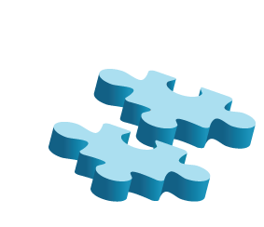
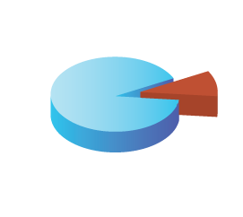
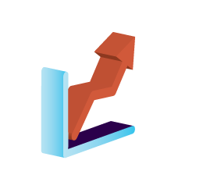
Microservices Context Building Per User Story
A Representational View
Analysis
Requirements
Conceptual Design of Microservices
Output
Bounded Context Definitions
Bounded Context Entities
Microservices Definitions
Microservices Boundary
Scope
Functional
Requirements
Integration Definitions
Data Elements
Risks
Select a User Story
User Story Scope Defined
Scalability Portability
Interoperability Other*
Data Entities
Functional & NFR Defined
Technology Stacks
Feasibility
Dependencies
Non-Functional
Requirements
Environments
Integration & Dependencies Identifications & Scoping
Integrations
Governance, Communications, Repositories, Teams

Slide 33
Solution Approach - Design

Slide 34
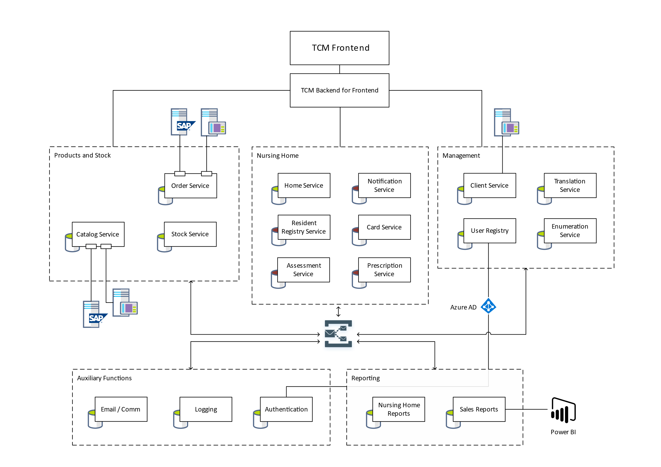
Solution Approach
Application re-writing - Functional
A proper architecture scales when you need it to.
One method in this toolbox is to decouple it physically, comprised of microservices.
Separating your services, and giving each service its dedicated database, and with best-practices and modern technology.
We plan to build TCM 2.0 with an architecture where horizontal scaling and data distribution works in your favor.
Leveraging this with Azure, we can gain hyper-scale growth, where individual parts of the system are scaled appropriately, and where potential bottlenecks are identified and handled accordingly.
Conceptual example – to be improved based on further analysis

Slide 35

Partner Rotation System – Logical Architecture
Gateway Layer
Load Balancer
Microservices
Integration Services
Controller
Internal
PM
CCT
CM
UM
RP
Voyager
CEA
Voyager
Nodes/Pods
Leap
RIL
Microservices
HR system
Controller
Controller
PM
CCT
CM
UM
RP
Data
Hub
EQI
Integration Layer
Nodes/Pods
External
Application Users
Third Party
Microservices
Controller
Controller
PM
CCT
CM
UM
RP
Data Services
Nodes/Pods
Containerization Clusters
PLANNED MICROSERVICES:
PM – Partner Management; CM – Client Management; RP - Reports; CCT – Country Compliance Tracking; UM – User Management

Slide 36
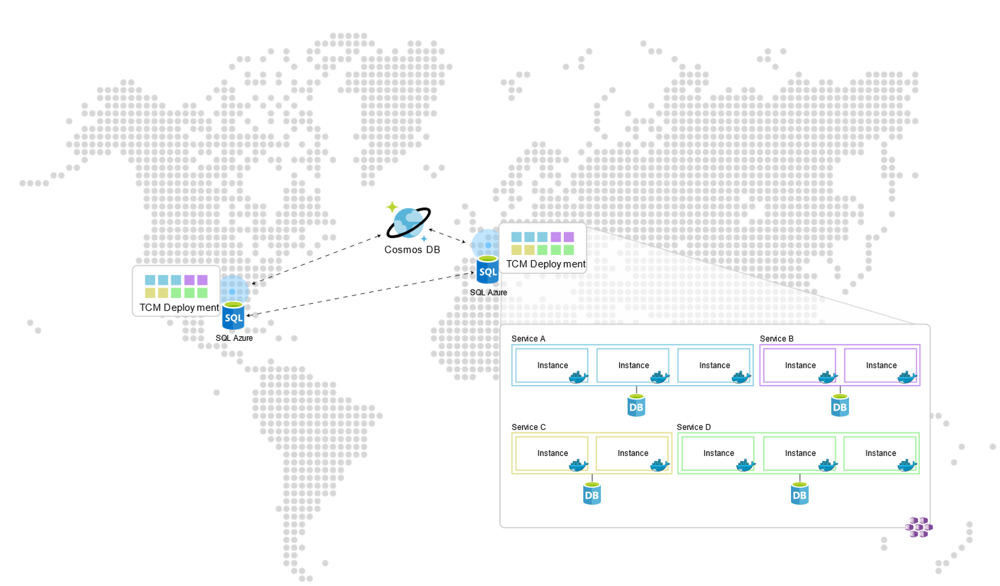
Solution Approach
Application re-writing - Distributed
By utilizing PaaS database offerings – Cosmos DB and SQL Azure, one will be able to utilize its state-of-the-art global distribution mechanisms.
On top of this, we’ll be able to distribute the compute deployments to multiple locations, where Azure’s Traffic manager will route the user to the closest destination, allowing us to provide a fast user experience with low latency.
A microservice architecture will allow us to scale services independently based on functionality required. The same goes for the databases, as they are dedicated per service.

Slide 37

Logical Design to Detail Design Conversion
OneNative Reference Architecture Applied on GT Requirements
Applications Solutions
Backends for Frontends
Micro services for Web Apps
Microservices Boundary
Country based Compliance Tracking
Sidecars
API Gateway
Client management
Data Elements
User Management
Ambassador
Gateway Offloading
Gateway Routing
Partner management
Gateway Aggregation
Reports
Integration Point Microservices
Azure
Shared Services
Data Entities
Detail Design Functional & Non Functional
Dependencies
Strangler
Integrations
Anti-corruption layer
GT External Systems/Data Feeds :
CMS
Data Hub
CEA
HR System
Partner Rotation System
RIL
Voyager
EQI

Slide 38
Solution Approach
Application re-writing - Cloud Landing Zone
Utilizing Sogeti CloudBoost library’s AKS Landing Zone design, templates and scripts, we ensure a fast and mature setup of the Essity AKS landing zone.

Slide 39
Partner Rotation Deployment View on Azure
Containers Description
Firewall,LoadBalancer– Azure Application Gateway
Reverse Proxy, Service Gateway– Kubernetes APIs
Database Managed SQL Instance
Managed Container Service– Azure Kubernetes Service
Authentication– Azure AD
Governing Services- Azure Key Vault,NSG,Azure AD
Monitoring and Shared Services – Application Insights, Redis Cache, SendGrid.
Integrate Data Source – Azure Data Factory
39

Slide 40






DevOps strategy
Ring deployment of services in an independent release cadence
Git Commit
Build code
Deploy to team environment
Deploy to Canary
Deploy to Early adopter’s
Broad deployment
Git Pull Request
Unit tests
Integration tests
…
…
…
Team review
Code validation
Deployment validation
Cloud validation
Approvals
Package
Monitor
Register
Enable for team
Team
Early Adopters
Canary
Broad deployment

Slide 41
Build Execution Phase
App Development:
Refer Design Documentation \ Automation Scripts
Build Unit & Functional Test Cases
Develop Functional Components
Develop NFR Components
Develop Integration Points
Testing:
Pick Up Sprint Ahead Stories
Define Test Cases
Develop Automation Scripts
Microservices
Development
Database Development:
Refer Design Documentation
Build New Schema Scripts
Run & Test
Database
Development
& Testing
OneNative Development Framework – AcceleRight, OneDeploy & CloudBoost will be used.
Provision
Cloud
Environments
Platform Build:
Infra Provisioning
AKS Setup
Microservices Deployment
Leverage CloudBoost + OneDeploy
DeveOps:
Build Deployment Scripts & Templates
Build\Modify Pipelines in Azure DevOps
Build Microservices
Run Automation Test Scripts
Build & Test
Collaborative
Planning
& Design
Detail Design Functional & Non Functional
Sprint Scoping:
Groom Stories
Sprint Scope definitions
Define User Acceptance Criteria
Define Deliverables
Backlog Planning
Sprint Ready For Release
Scope, Develop, Build, Test, Provision and Deploy in each in scope Environment

Slide 42
Sprint Design – Quality Assurance
GATE 5
Verify Deliverables & Acceptance Criteria
Sprint Ready for Release
GATE 3
Sprint Development
Validate Performance Testing Strategies
Validate Industry Design Standards & Security Compliances
Development team will meet performance /scalability linked non–functional requirements & Standards
GATE 1
Deployment &
Sprint
Approvals
05
Review Sprint Scope and acceptance Criteria
Review Deliverables
Testing & Verifications
04
Development
GATE 4
03
Architecture & Design
Code review of critical use cases
Validate use of appropriate tools for unit testing , static code analysis and security vulnerabilities, continuous integration
Development team will perform corrections on findings
02
Sprint Start
01
Slip Over to Next Sprint
GATE 2
Establish best practices, guidelines and tools to be utilized
Define Security Controls & Compliances
Validate design patterns and principles to be used in current sprint

Slide 43





Security approach
Identity and access management via Azure Active Directory.
Nursery homes groups
Admin user groups
Admin module creates groups
Resource security via claims
Release pipeline security groups
Approval groups
API and Web Resource access
Identity
IP whitelisting
API Management, routing.
App Gateways + Firewall
Secret management
Secret creation via release pipeline
Rotating secrets via automation
Secret access via identity
Data
Encryption at rest on Cosmos DB & SQL Azure
Encryption in transit via SSL
In Cache (when needed)
Monitoring, logging and auditing
Continuous
Automated alerts

Slide 44
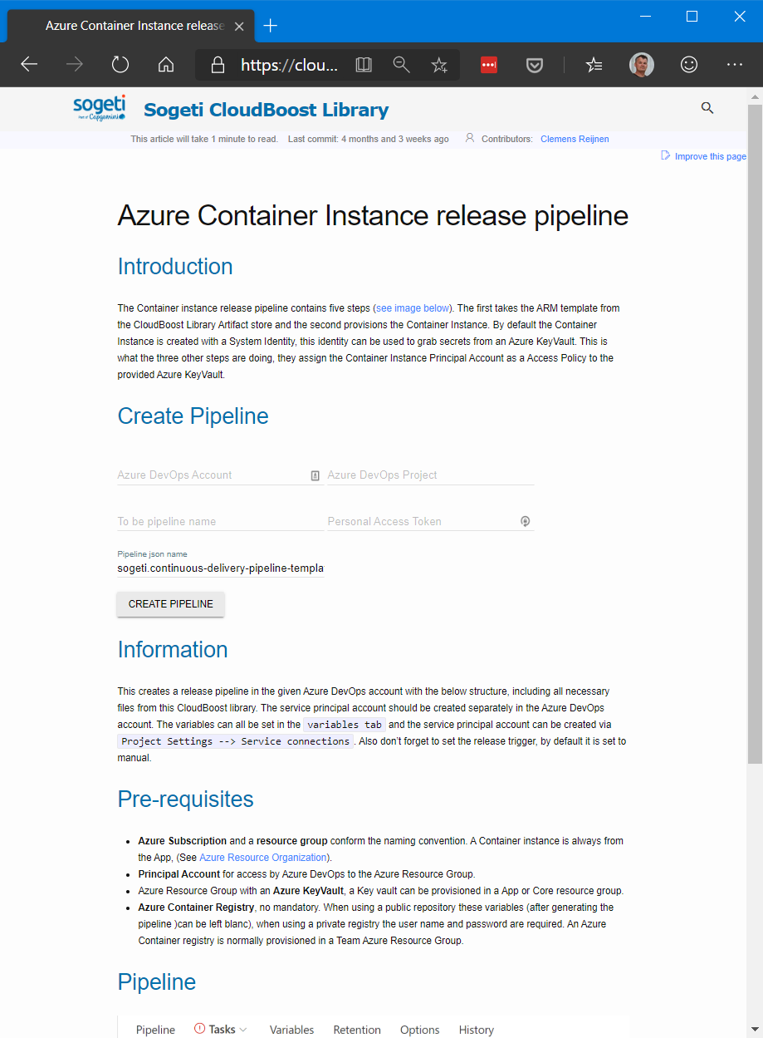
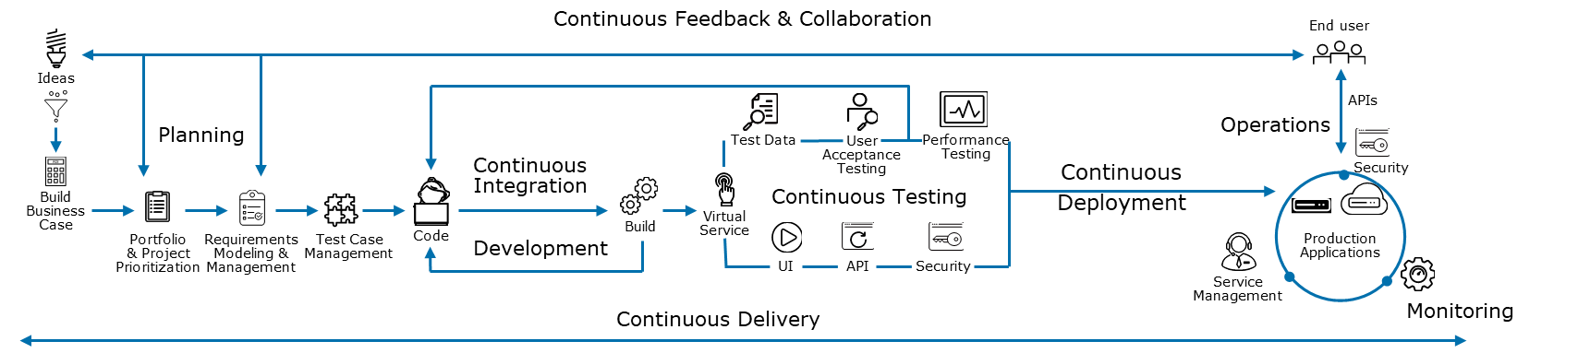
OneDeploy
OneDeploy is a Framework for DevOps. It contains pre-built scripts and integrations with various CI/CD ecosystems based on the DevOps reference architecture.
Increased speed, efficiency, and quality of software delivery
Reduced communication barriers between teams
Agile development, faster resolution of problems
Reduced release cost up to 60%

Slide 45
Kubernetes vs PaaS prospective for Partner Rotation
 | Azure Kubernetes Services | PaaS (Azure App Services & Azure Functions) | Comparison Comments
Scalability | Kubernetes supports horizontal pod scaling to adjust the number of pods in a deployment depending on CPU utilization or other select metrics | Scale Up and Scale Out options are available as part of this offering. Scale Outs can be based on CPU Utilization and other metrics | There does not seem to be a material difference here as both offerings can scale as needed using Azure resources
Reliability | Highly Reliable. Platform Monitored deployments | Highly Reliable. Platform monitored deployments | Potentially Kubernetes deployments would be able to handle failures and redeploys faster
Deployment | Highly Agile and Isolated, Decoupled deployments | Agile but coupled deployments | Kubernetes has better tooling and support for orchestrated deployments
Flexibility | Move and Scale as per changing Business needs. Port applications from machine to machine and across vendors | Typically smaller teams with simple applications to run those in the cloud without the DevOps | PaaS models are typically more restrictive in terms of extensibility and portability
Continuous Development & Deployment | Kubernetes can push new changes to the host containers and deploy in the background | This requires explicit interventions by developers/DevOps teams to deploy and plan cutovers | Kubernetes & Containers can handle the workload with little interference from developers
Time Slicing | None | App Services – None Functions – Max. 10 minutes approx. | Functions would be a choice only for short and time quantified code executions
Microservices Model | Well suited for a Microservices design based on isolation | Can be fit on a PaaS model | PaaS are not natively tuned for Microservices based designs or models
Development Stacks | Very little or no limitations except legacy technologies. Polyglot Stacks | Only PaaS vendor defined stacks and versions are supported. Usually single technology stack | Containerized hosting environments are extremely flexible over PaaS platforms
Development Environments | More complex setup in the environments to integrate with potentially any container registries and container builds | Usual\Standard app development experience | Containerized are typically more complex to setup but these are one time activities
Cost | AKS charges only for the Azure Compute and Storage capacity used | This is a fairly cheap offering but if dedicated environments and isolation is needed cost can increase significantly | Basic offerings in bot are cheaper but AKS would be more cost effective for larger systems or considering growth in future
Think of Kubernetes and the cloud native community as a set of building blocks to construct any number of different solutions and no longer being held back or restricted by PaaS providers. Even if currently a simple application with a relatively smaller user base is used, it’s likely going to scale and change rapidly. Preparing for the future by moving to containers now is going to save time and money when it becomes criticality later on.

Slide 46







Testing Approach
Functional & Automation Testing
Performance Testing & Performance Monitoring
API & Service Integration Testing
Test Environment Provisioning & Orchestration
Browsers & Application Supports
Technology supported
Compatibility with Major SaaS , PaaS or Containerized platform
Support for Browser Compatibility & Accessibility
Web service & Data driven Testing
Integration with CI and Open Source tools
Support for web & Mobile Application and Protocols
Support for webservice, SaaS, PaaS & Container application
CI Tool Integration
Application Performance & Server side Analysis
Performance Monitoring
Business and performance analytics
Support Code level / Transaction Level Analytic
Plug and play, Pay as Use
Support for all application Layers (UI, Mobile, middleware, database, Host )
User experience
Support Webservice
Support for CI
Record and Playback
Integration with Lifecycle tool, reporting, SOA Testing
Service Virtualization
Supported Protocols & Technologies
Supported SaaS applications
Support for PT, Database virtualization
Support Cloud Configuration automation
Automation and deployment orchestration
IaaS Code management, Security & Compliance
Visualization and reporting
Support Devops & Continuous Deployment
Mobile Functional & Automation Testing
Security / Compliance Testing
Data & Analytic Testing
Application Migration Testing
Support for Cloud (Public & Private)
Devices pool Availability for Manual & Automation Testing
Support for parallel testing on both iOS & Android
Support for Performance testing
Scan IaaS, firewall & Network
Support to validate Penetration testing , Sniffing
Support for Static, Dynamic & IAST security testing
Validate File and Data integrity
Threat & Attack Intelligence
Dashboarding & Reporting
Database & Services Supported
Datatype Mismatch, Data reconciliation, Heterogenous Comparison
Reporting and Dashboard features
Security, Masking & Compliance Support
Support to validate App Security
API integration
Support IaaS as code
Operation, Security & Auditing
Unified view of operational data
Native integration as well as Third party integration
Tracking Automated Resolution
Pay as you go

Slide 47


Sogeti Delivery Model & DevOps Culture
DevOps Target State
Azure DevOps
OneDeploy
CloudBoost
Integrate GT tools for:
Code Analysis
Testing
Joint teams that cover the entire solution lifecycle.
Lead architect owns entire solution including functional and non-functional covering design, build, test and run.
Extensive collaboration
Knowledge sharing.
Single overall process covering the entire solution lifecycle – from design, build, test to run.
Clear visibility of all projects/changes that are at different stages
Clear view on environment setup, NFR and Security Compliances
End to End release automation
Infrastructure Provisioning as a Code
Release Pipeline as a Code
Configuration as a Code
Monitoring integration as a Code
Consolidated Dashboard

Slide 48
AcceleRight Frameworks [Cloud Native Reusable Components]
What is AcceleRight
AcceleRight
Web and API
AcceleRight
Declare
AcceleRight
Secure
AcceleRight is our Framework having pre-defined reusable components to expedite the Native Developments.
Accelerated Web UI and Web API Platform
RIGHT configurations to build and deploy
RIGHT Frameworks pre-configured
RIGHT Project structure pre-defined
RIGHT Base design in place
Declarative Exception handling
Declarative Transaction management
Declarative Business validation
Declarative Caching
Logging framework
Performance Instrumentation
Authentication and SSO
Authorization
Functional entitlements
Data entitlements
Authorization token generation
AcceleRight
Metrics
AcceleRight
Ship
AcceleRight
Service Discovery
AcceleRight
API Gateway
Integrated Code Quality Measurements
Integrated Code Complexity Measurement
Integrated Code Coverage Measurement
Code Templates and Standard code generators
Micro App modules with micro services
Dev-ops ready with containers
Integrated Web containers and servers to the build
Rapid development and integration
Node and service registration
DNS based service discovery
Health check of underlying nodes
Load balancing of services
Ensures resiliency
API registration
API discovery
API metering
API rate limit

Slide 49




DevOps Setup
DevOps Team goals and metrics
Secret management
GOALS:
Reduced cycle time
Early feedback
Increased predictability
Lower software delivery risks
Automation and traceability
Monitoring and auditing

Slide 50
Sprint Quality Assurance
GATE 5
Verify Deliverables & Acceptance Criteria
Sprint Ready for Release
GATE 3
Sprint Development
Validate Performance Testing Strategies
Validate Industry Design Standards & Security Compliances
Development team will meet performance /scalability linked non–functional requirements & Standards
GATE 1
Deployment &
Sprint
Approvals
05
Review Sprint Scope and acceptance Criteria
Review Deliverables
Testing & Verifications
04
Development
GATE 4
03
Architecture & Design
Code review of critical use cases
Validate use of appropriate tools for unit testing , static code analysis and security vulnerabilities, continuous integration
Development team will perform corrections on findings
02
Sprint Start
01
Slip Over to Next Sprint
GATE 2
Establish best practices, guidelines and tools to be utilized
Define Security Controls & Compliances
Validate design patterns and principles to be used in current sprint

Slide 51

Proposed Project Governance structure – Leveraging Existing Model
INITIATE
Give a final go ahead and Approvals
Provide Vision
Authorize corrective actions if required;
Arrange availability of resources & Sign off
Executive Sponsor
IT Delivery Executive
Issue
Executive Sponsor
Program Manager
Quarterly
Resolve
Steering Committee – Vision & Investments
ASSESS
Escalate
Roadmap control
Governance Setup
Strategic decisions
Project Planning
Environment Access
Facilities Access
Tools Access
Portfolio Managers
Issue
Delivery Manager
Enterprise Architect
Resolve
Project Leadership – Roadmap
DESIGN & BUILD
Escalate
Architecture Design
Tactical decisions
Daily Backlog management
Provide Functional Test Cases
Application Technical & Functional SME Support
Product Managers
Project Manager
Dev. Architect / Tech Lead
Test Architect / Test Lead
Cloud Architect
Issue
Resolve
Backlog Planning, Tracking & Execution
Development
QA Testing
Deployment
Bug Fixing
Manage Application on Cloud
Product Owners / SME & UAT Sign off
Go Live Approvals
Escalate
Product Owner / Business Users
Dev. Team Lead
Test Team Lead
Developers
Testers
Issue
RUN
Resolve
RUN & Manage

Slide 52









Sogeti has Strategic Partnerships with Microsoft Azure…
THE PARTNERSHIP
Active competencies:
Gold Cloud Platform
Gold Cloud Productivity
Gold Data Platform
Gold Data Analytics
Gold Datacenter
Gold Application Integration
Gold Application Development
Gold ALM
Gold Communication
Gold Messaging
Gold ERP
Gold Devices/Deployment
“Sogeti has reached the status of Gold recognition by exhibiting increased levels of real world experiences and expertise through customer projects that were independently verified by Microsoft.”
19 Years as a Microsoft Partner
THE PEOPLE
Out of over 640,00 Partners; nearly 100,000 Certified Microsoft Partners, only .5% of the Microsoft Partner Network is actually “Managed” by Microsoft. Sogeti is one of the .5%.
1000+
Azure Certified Consultants
THE RECOGNITION
Microsoft Awards
Azure EPG Leadership (2017)
Devices and Deployment Partner of the Year (2017)
Cloud Innovation Azure Partner of the Year (2012)
System Integrator Azure Partner of the Year (2012)
Azure Special Recognition Award (2012)
500+
Azure Focused Architects
David Sugarman, Director
US One Commercial Partner Team
Microsoft Corporation
THE COMMITMENT
One of the first partners to focus heavily on Azure.
Joint Microsoft Sogeti Agreement to Create the Azure Privilege Club in 2011.
Members of the Azure Partner Advisory Council
Dedicated Global Azure CoE
One of only three firms to ever been named Enterprise Partner of the Year
2000+
Currently
in Training
“We are excited to extend our partnership with Sogeti, a leading global systems integrator, to help customers accelerate their business agility, productivity and efficiency.” Scott Guthrie, Executive VP, Cloud & Enterprise, Microsoft
GT–Partner Rotation System | Application Mod

Slide 53
Sogeti can leverage Microsoft Relationship at different levels
Global Microsoft Alliance Gold Partner
Gold Application Development • Gold Application Integration • Gold ALM • Gold Cloud Platform
Gold Collaboration/Content • Gold CRM • Gold Data center • Gold Devices/Deployment • Gold ERP
Gold Hosting • Silver Data Analytics • Silver Data Platform
Experience of working with and access to Microsoft Resources:
Route to high level MS escalation engineers and product group for incident resolution
Partner Team
Premier Support
Microsoft Consulting
Product Group Consulting
Executive Escalation
Microsoft Product Groups / Executive Relations
Microsoft Consulting Services & Pre Sales
O365 Specialist Sales
Partner Account Manager
Technical Account Managers
IT Architecture & Planning Consultant
Client Account Manager
Sogeti
Sogeti
Sogeti and GT
1B€+
in Microsoft Services Revenue
Winner of Multiple Microsoft Partner of the Year awards
12 Gold Microsoft Competency Certifications
One of the top 3 Microsoft Strategic Alliances
Creating Innovative Microsoft Solutions featuring Cloud, BI, Mobility, App Dev, Infrastructure, Testing & Security

Slide 54
Roadmap migration and modernization factory
Lifts shift Application migrated
First Application modernized
Tuned business case and planning
Information complete
Migration done
Basic information know
Lift shift and modernize first selection
Bulk migration and modernization
Assessment
1
2
3
4
Phases

Slide 55
Proposed High Level Plan
Month 1
Month 2
Month 3
Month 4
Month 5
Month 6
Month 7
Discovery
Discover
Requirement Gathering
Build and
Execution
Detailed Design
UI and API development and Unit Testing
Write QA test plan, test scripts and execute
Build CICD Pipeline
Write infrastructure automation scripts and build environments
Database Migration
Build Disaster Recovery environment
Support
Contingency
Warr
anty

Slide 56
Sprint plan
Team size: 7 people
Sprint length: 3 weeks
Sprint 1 to 3:
Preparation and assessment. Initially start with expert architects to set up project. Start building the core of the system, with first features.
Sprint 4 and onwards:
Core team from sprint 3 will branch out and lead a team of developers, developing functionality to the TCM application.
Sprint 1
Sprint 2
Sprint 3
Sprint 4
Sprint 5 - 12
BA
Identity & Security Expert
Architects / SMEs
UI & UX team (On-site as well)
BA
Architects / SMEs Frontend and backend devs
Architects & Security SMEs Frontend and backend devs Quality Assurance roles
Architects & Security SMEs Frontend and backend devs Quality Assurance roles
Security Design, Threat Model, Validated identity technology and roles. Clarified use cases. Defined user experience.
Base of Landing Zone and DevOps toolchain. Backlog plan started. Detailed services architecture defined. First UI visuals accessible running on AKS.
Monitoring, networking, logging and auditing in place.
First modules features realized and validated on frontend and backend.
Features continuously added by devops team. Continuous testing on compliance, security and performance. Optimizing landing zone.
Team size
Landing Zone setup
CI/CD setup
Landing Zone Team
Landing Zone Team
Identity & Infosec
Define services
Data design
Module Team 3
Module Team 3
UI & UX Studies
Frontend and UI foundation
Landing Zone Team
Module Team 2
Module Team 2
Sprint 0:
Setup Team, access, roles & Env setup
Feature Deep Dive
Backend Core
Expert Module Team
Module Team 1
Module Team 1
Expert and management support members: UX | Technology | scrum master | DevOps | … | …

Slide 57
Relevant Domain Experience

Slide 58





Re-design Telematics Solution in Cloud for EMC
Top 50 US based commercial property and casualty commercial insurer leveraged Sogeti’s Global Delivery Model to remediate and enhance a portal inherited from a previous vendor. The purpose of the this portal is to provision, administer, and support a telematics solution for automotive fleet insurance on Azure.
Client Overview
Background
Solutions
Benefits / Results
Client partnered with Sogeti to assess, remediate and enhance the partially developed portal created by another vendor.
The portal had an inconsistent UI/UX experience and database design.
Development standards were not being followed impacting code quality, consistency and maintainability.
Inconsistent Data Modeling techniques reduced response for resolving various queries and database issues.
Client depended on highly manual test process to ensure software efficiency and quality of software functions.
Sogeti enabled a complete redesign of the UI/UX for the portal. CSS was used to create customized templates replacing Bootstrap to enhance design flexibility.
Sogeti made use of Azure Functions to continuously check external API availability. This ensured smooth functioning of GUI components and use of ReSharper tool provided additional code analysis and refactoring features.
For automating data movement and data transformation, Sogeti used ‘Azure Data Factory’ to create data-driven workflows in the Cloud.
Sogeti developed automation test cases which enabled faster and more consistent testing of core functionality.
The Results realized are:
Improved UI/UX experience.
Improved agility that would enable implementation of new features with ease and precision.
Complete redesign of database to remove any inconsistency in modeling technique.
Auto-build and auto-deployment by CI/CD pipeline.
Increased security through better authentication authorization.
Improvement in application scalability for large userbase and maintainability.
Technologies: .NET MVC, Azure, SQL Server

Slide 59
Development of a harmonized web application for Westdeutscher Rundfunk
Westdeutscher Rundfunk Köln (WDR, West German Broadcasting Cologne) is a German public-broadcasting institution based in the Federal State of North Rhine-Westphalia with its main office in Cologne.
Client Overview
Background
Solutions
Benefits / Results
The departments for production and technology were working with different processes and tools for resource planning
Allocation of resources across departments is not governed by standard procedures and has no appropriate support by an integrated IT solution
Entering of actual time efforts is performed via an SAP solution, which especially is not very convenient for employees with lots of travel activities
The heterogeneous process and system landscape leads to an inconsistent data base for the calculation of KPIs (e.g. key productivity indicators).
Capgemini ran an ASE workshop with representatives of the departments to define the to-be processes together.
The processes were made to be harmonized and an established, industry-specific application was implemented as the standard tool and integrated to the existing SAP solution for tracking of actual time efforts.
The web application was launched for the employees that shows the most up-to-date version of own assignments and selected resource plans.
Time tracking is also performed via the mobile web application including pre-filled data from resource planning to increase data quality.
Various change management measures are applied to embed the transformation in the organization.
Harmonized processes and a standard tool facilitates the allocation of resources across different departments.
In future, the publishing process for resource plans can be performed via a digital i.e. paperless workflow.
Production staff benefit from a handy mobile solution for getting an overview on assignments and for actual time tracking.
Process standardization leads to a harmonized data base and an increase in business performance transparency.
The harmonization within the division acts as the basis for future projects with regards to workflow optimization and system integration.
Notes:
No changes

Slide 60
Moving to a new cloud based solution to support new devices for future growth using Big Data, microservices based architecture
Client is an American health care company with headquarters in Lake Bluff, Illinois, United States. The company was founded by Chicago physician Wallace Calvin Abbott in 1888 to formulate known drugs; it eventually grew to also sell research-based drugs, medical devices, diagnostics, and nutritional products.
Client Overview
Background
Solutions
Benefits / Results
Client monitoring network allows doctors to review patient bio-metrics captured from a range of implanted and wearable devices.
New monitoring devices (Reveal LINQ) have created a hockey stick growth in data volumes and the velocity.
This has caused strain on the monitoring network and Client’s ability to support the monitoring network.
Client was investing in the Altair program to extend the life of monitoring network by offloading the Reveal LINQ device data to a new modern cloud-based platform built on Big Data, microservices based architecture and ADFS.
Data Ingestion, processing and framework development in Big Data.
Develop a new UI framework using the latest UI technologies like Angular JS 5 and Redux.
OneDeploy solution to automate the CI/CD flow
Transformation to a new cloud based solution which supported new devices for future growth.
Moved to a Responsive UI and newer UI technologies which improved UI performance and supported newer mobile devices.
Centralized ADFS authentication replacing the authentication done via multiple system based authentication methods.
Notes:
No changes

Slide 61
Innovation roadmap using micro services architecture with distributed server less computing with PaaS and SaaS
Client is a non-profit health system in the United States, based in Phoenix, Arizona. It operates 28 hospitals and several specialized facilities across 6 states
Client Overview
Background
Solutions
Benefits / Results
Client created Digital Garage Imaginarium to spearhead innovation and voice, mobile and web apps were identified as the most promising innovation domains.
Client was using several third party platforms to support their business needs and these platforms did not meet the required criteria to create engaging, innovative apps that would promise user adoption.
These third party platforms were becoming a bottleneck for innovation
To solve this challenge Capgemini architected Azure API layer to support the new consumer engagement initiatives.
We used micro services architecture with distributed server less computing with PaaS and SaaS offering from Azure.
This helped speed up the innovation roadmap for Client
Details of Technology stack used:
AWS, .Net, Azure APIM portal, Azure Functions, CosmosDB, Azure Storage, EventGrid, Application Insights, Azure KeyVault, Security Center, Dashboard
Client has successfully implemented several business initiatives on the Innovation roadmap.
Azure APIs are currently supporting web, mobile and voice apps in production without any downtime and scales horizontally to handle any number of requests while getting charged only for use. These APIs are reusable with a professional grade Azure APIM portal for developers and admins.
All Client developers can leverage these APIs and potentially revenue could be generated by partnering with Kyruus and Clockwise.md to sell to their clients.
Capgemini team successfully demonstrated the use of Azure Platform for Client and created a path to put Client in the forefront of innovation in HealthCare in cost-effective, secure and compliant way.
Notes:
No changes

Slide 62
Designing the Making Tax Digital (MTD) program for HMRC using a microservice-based architecture
Her Majesty's Revenue and Customs (HMRC) is a non-ministerial department of the UK Government responsible for the collection of taxes, the payment of some forms of state support and the administration of other regulatory regimes including the national minimum wage
Client Overview
Background
Solutions
Benefits / Results
In 2016, HMRC embarked the Making Tax Digital (MTD) program to change the way customers interact with the Department.
Capgemini worked collaboratively with HMRC in a joint architecture team to design the solution supporting incremental roll out of the solution.
HMRC selected this as the way forward for Making Tax Digital based on this demonstration. It has been adopted by all suppliers working on the program
Capgemini demonstrated how a microservice-based architecture provided the speed and flexibility of deployment. This included demonstrating the tools and processes for development and operational support.
A core, multi-supplier team is developing the architecture.
Governance is managed through a Technical design Group (TDG), a body proposed by Capgemini, based on our experience in other large, multi-supplier projects. TDG is composed of technical leads from the program and reviews all significant designs and technical decisions.
Capgemini introduced a key change into the architectural thinking, decomposition of HMRC’s IT domain into sub-domains, each of which were internally cohesive and loosely coupled to other sub-domains. This decomposes the overall HMRC’s estate into manageable units with clear interactions.
The Income Tax Sub-Domain is the focus for MTD. This contains a number of new micro-services developed by different suppliers.
Capgemini used technologies and patterns (such as containerisation) that support HMRC’s ambition to move to hyperscale cloud. HMRC still needs to address some security and commercial considerations in order to realise that.
An API-based economy insulates users of functionality from its implementation.
Sub-domains simplify large-scale developments.
Incremental development delivers value frequently and can provide feedback.
Moving thinking from monolithic systems to microservices has led to a change in mindset for HMRC team involved
The design and technologies used to build and deploy the microservices will minimize the cost and effort of that move
Notes:
No changes

Slide 63
Implementation of the EMC PeakFleet portal application using Dot Net MVC, Azure, SQL Server
EMC is primarily commercial insurer
Client Overview
Background
Solutions
Benefits / Results
EMC PeakFleet portal application was half-developed by another vendor with poor UI/UX experience and Database Design.
Application logging was very limited and not sufficient to track the errors.
Development standards were not being followed impacting code quality, consistency and maintainability
Highly manual test processes were involved, especially regression and smoke tests
Inconsistent Modeling technique were used resulting in less valuable joins
Capgemini helped with implementation of extensive application logging for help in tracking application errors with ease and precision.
Solution involves automation of regression and smoke testing, especially of core functionality to enable improvement in speed and consistency of testing efforts.
Use of ReSharper tool provided additional code analysis and refactoring features.
Implementation of Azure B2C and enhanced security features.
There will be complete redesigning of UI/UX using CSS replacing Bootstrap to enhance designing flexibility
Key technologies used - Dot Net MVC, Azure, SQL Server
Improved UI/UX experience
Improved agility that would enable implementation of new features with ease and precision
Complete redesign of database to remove any inconsistency in modeling technique
Auto-build and auto-deployment by CI/CD pipeline
Making it much secured application that provided better authentication authorization
Improvement in application scalability for large user-base and maintainability
Notes:
No changes

