Slide 1
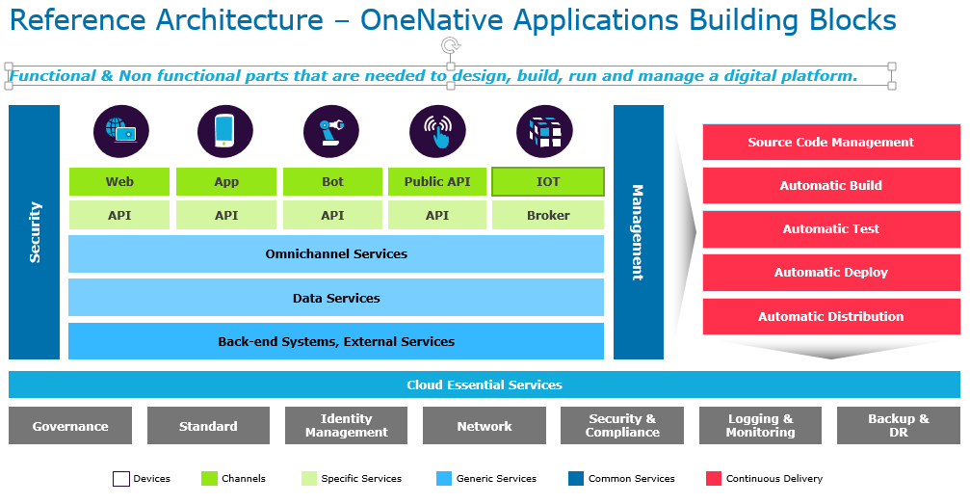
Reference Architecture – OneNative Applications Building Blocks

Slide 2
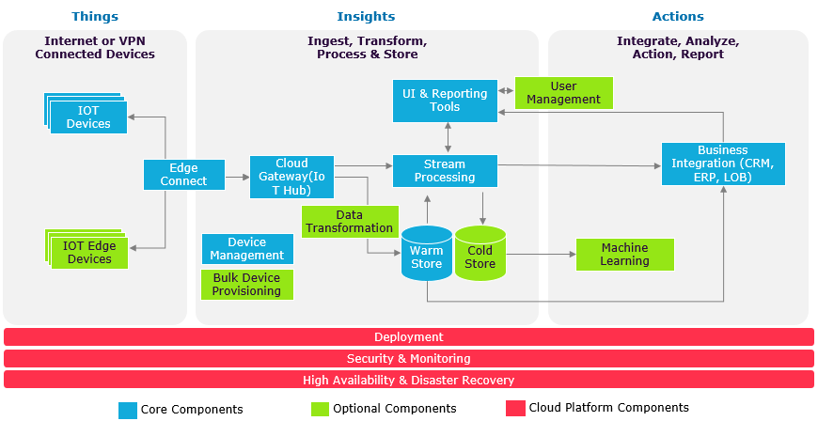
IoT Logical Diagram

Slide 3
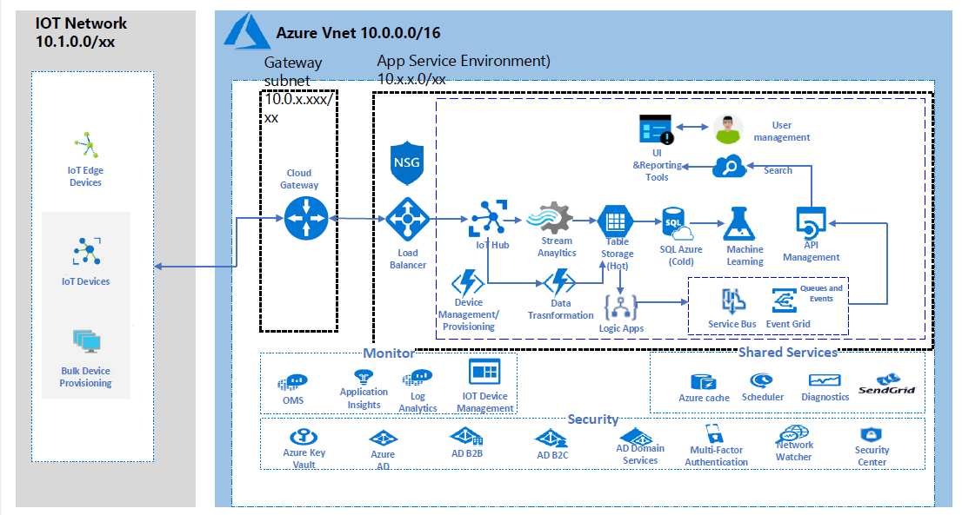
Azure IOT PaaS Deployment View
Security & Monitoring Design Principles
Isolated Integration – Edge Connect using side-by-side HTTPS, VPN, and Express Route considering IPSec tunnel & transit data encryption
Design to Scale Out – Cloud Gateway and resources behind Network Load Balancers and service increase options
Central Security Control - Using NSGs over VNETs, Traffic blocking rules, AD authentication, KeyVault, and AD Domain Services
Threat Resiliency built using OMS and Azure security center with detect, assess, diagnose, stabilize, and close principles
Monitor and Manageability - OMS dashboard pulling logs of type Activity, Diagnostic, Flow logs, and health of resources at application/network level
Other Deployment Options Could be Azure Service Fabric, Azure Container Service, Kubernetes & Docker EE.

Slide 4
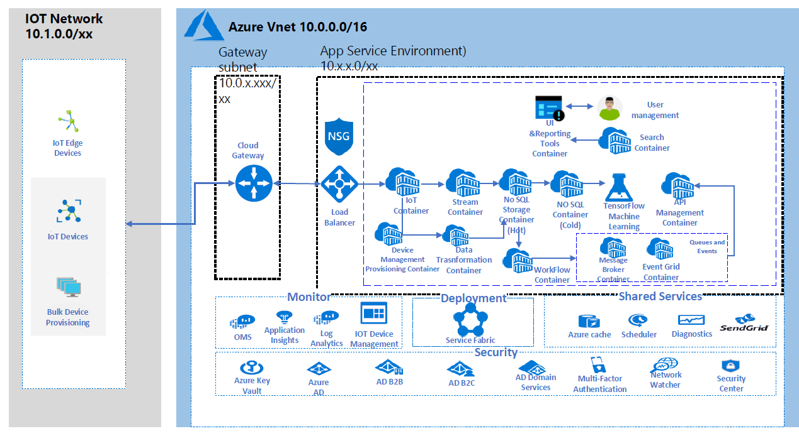
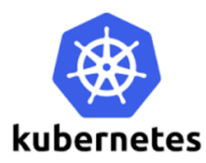
Azure IOT Containerized Deployment View – Azure
Containers Description
IoT Container – Kafka
Stream Container – Spark Streaming
No SQL Container – MongoDB, Elastic Search etc.
SQL DB
MS SQL
API Management Container – 3Scale API
Device management Provisioning Container – 3 Scale API
Data Transformation Container – 3Scale API
Workflow Container – Kafka
Message Broker Container – RabbitMQ
Event Grid Container – Pager Duty
Search Container – Elastic Search
Work Flow Container – Zaiper
Other Deployment Options Could Azure Container Service & DockerEE.

Slide 5
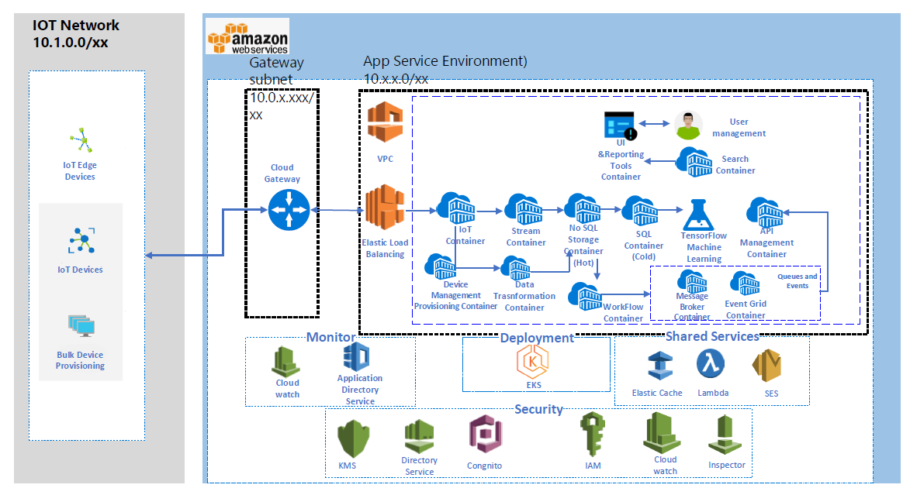
Azure IOT Containerized Deployment View – AWS
IoT Container – Kafka
Stream Container – Spark Streaming
No SQL Container – MongoDB, Elastic Search etc.
SQL Container – My SQL, SQL Server etc.
API Management Container – 3Scale API
Device management Provisioning Container – 3 Scale API
Data Transformation Container – 3Scale API
Workflow Container – Kafka
Message Broker Container – RabbitMQ
Event Grid Container – Pager Duty
Search Container – Elastic Search
Work Flow Container – Zaiper
Containers Description
Other Deployment Options AWS Lamda & DockerEE.

